Slide 1
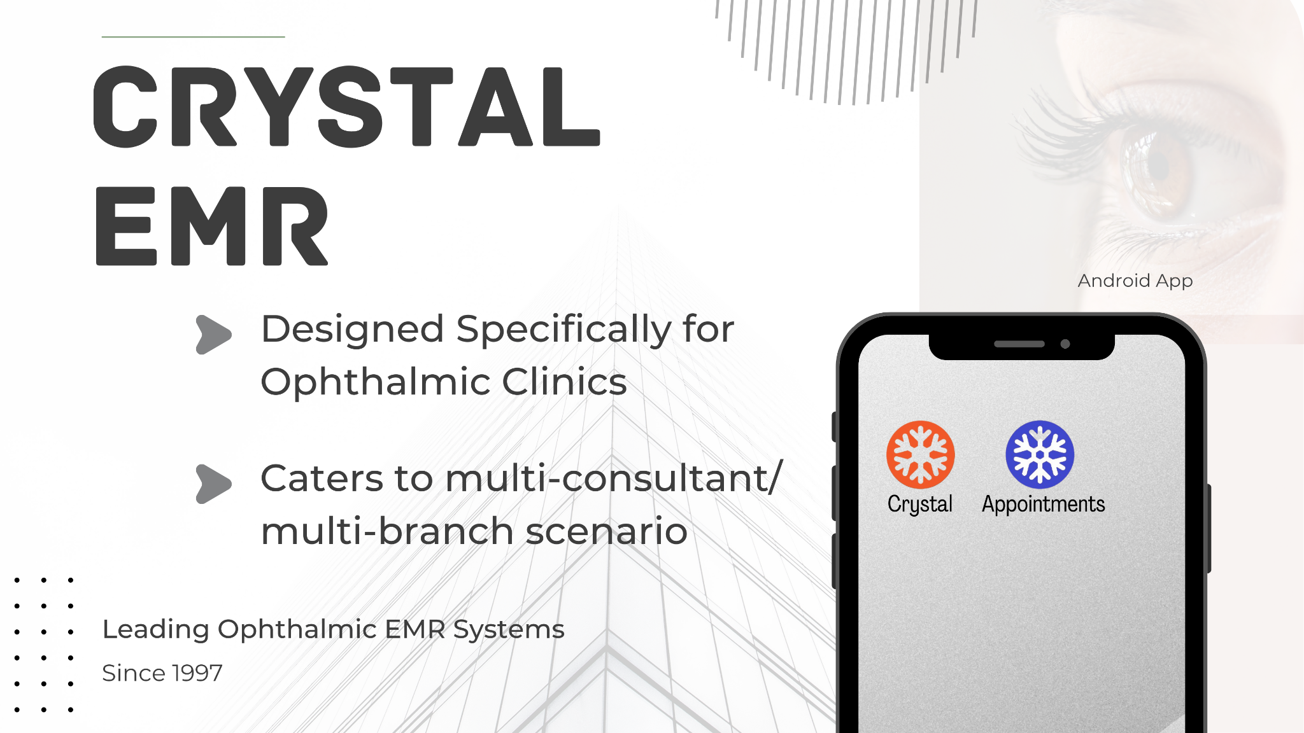
Notes:
Hello Everyone!, Let me introduce you to the Crystal EMR App.
Serving the ophthalmic community since 1997.

Slide 2
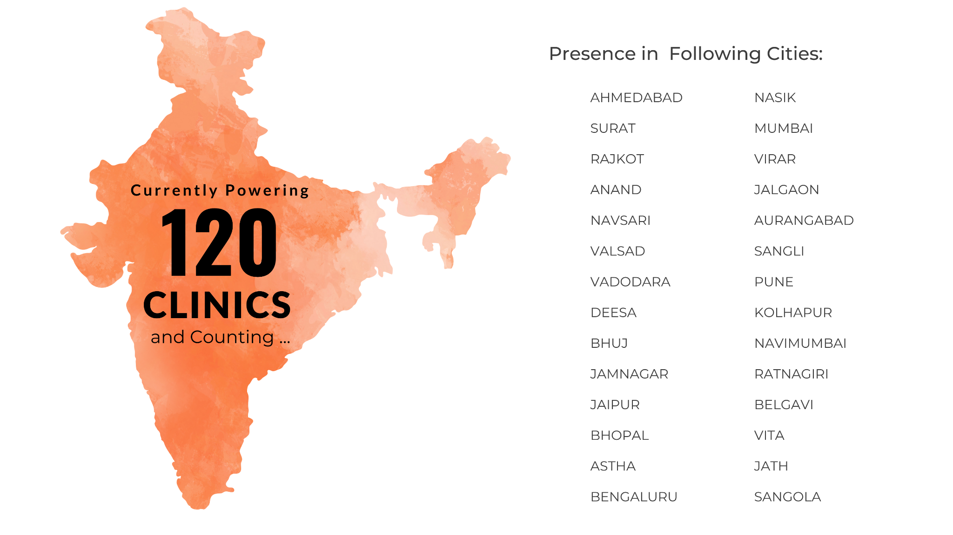
Notes:
More than 120 Successful Installation of Crystal EMR App in different cities of the country and counting.

Slide 3
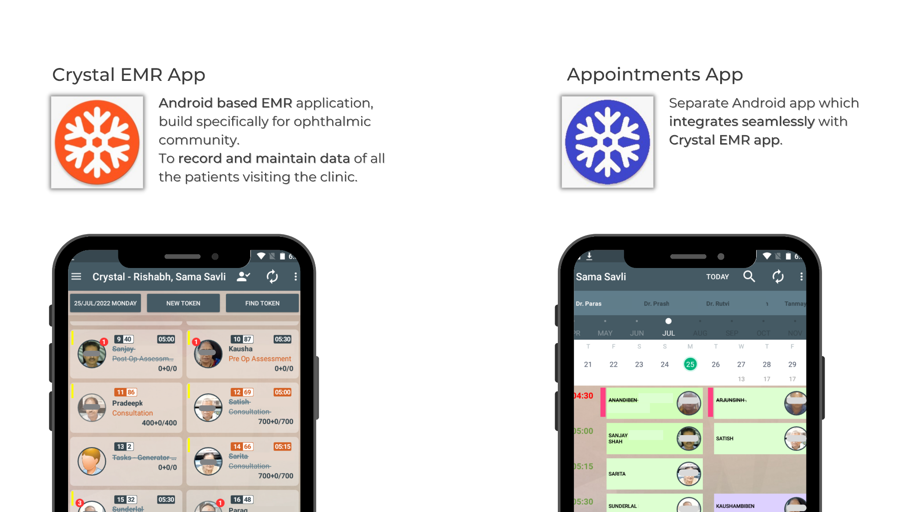
Notes:
Pure Android Based.2.Specific to Ophthalmologists Practice Pattern. 3.These are the only Apps which will be required for all the patient data capture. 4.Android reduces the hardware investment. 5.You just need one good server/Good wifi/Wifi printer/Android devices to run Crystal. 6.If opting for cloud, then the server also is not required at your end, only good Internet will be required.

Slide 4
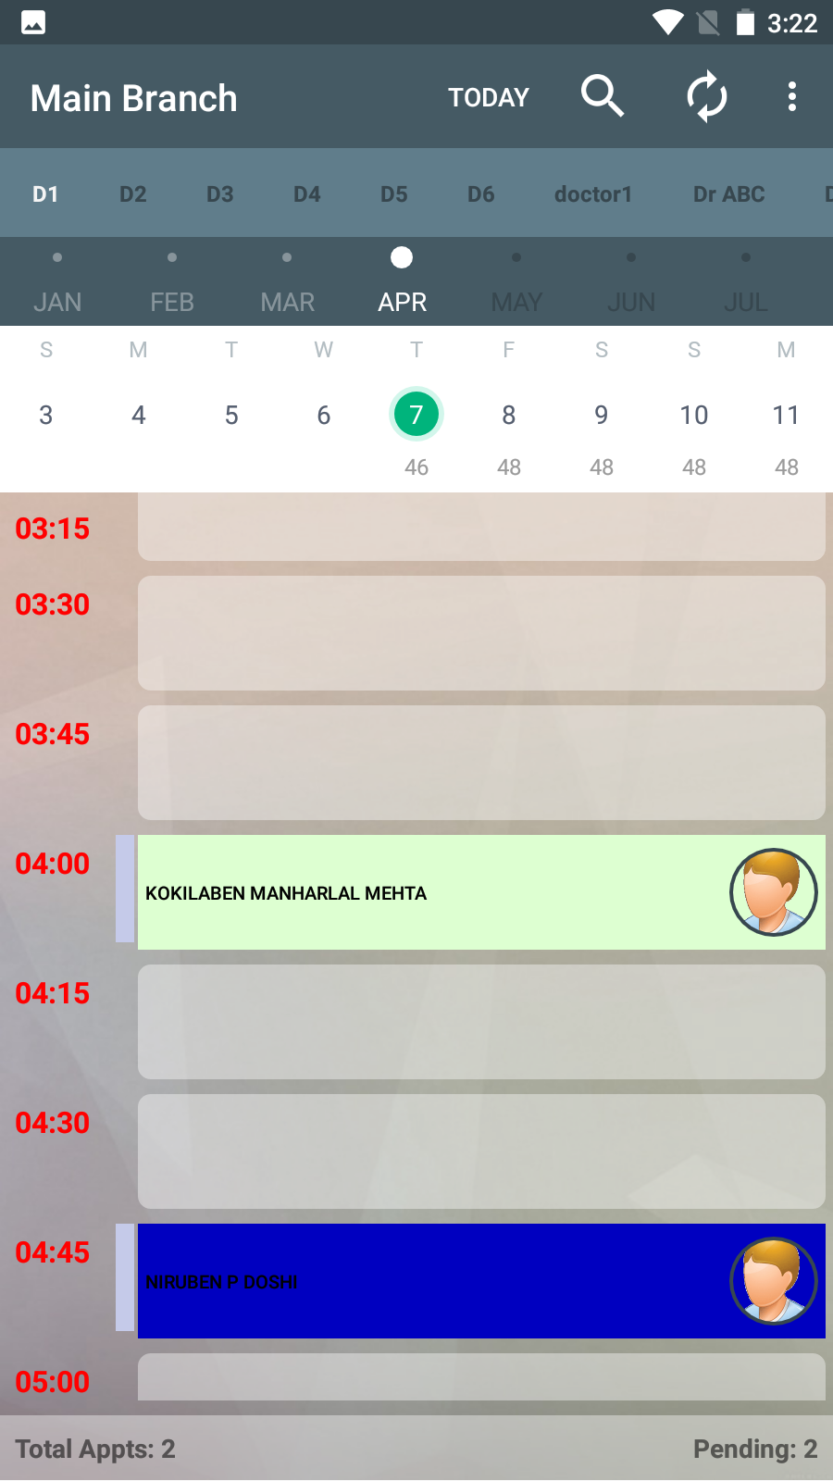

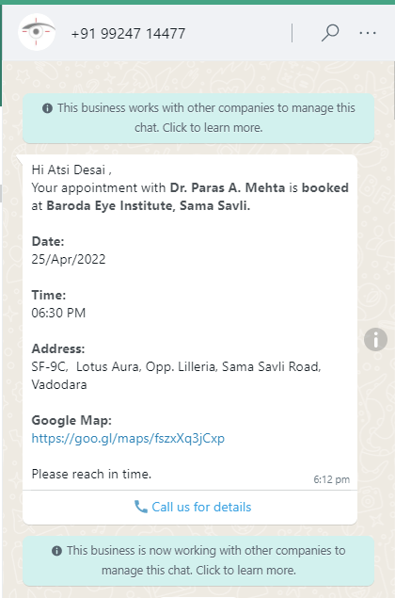
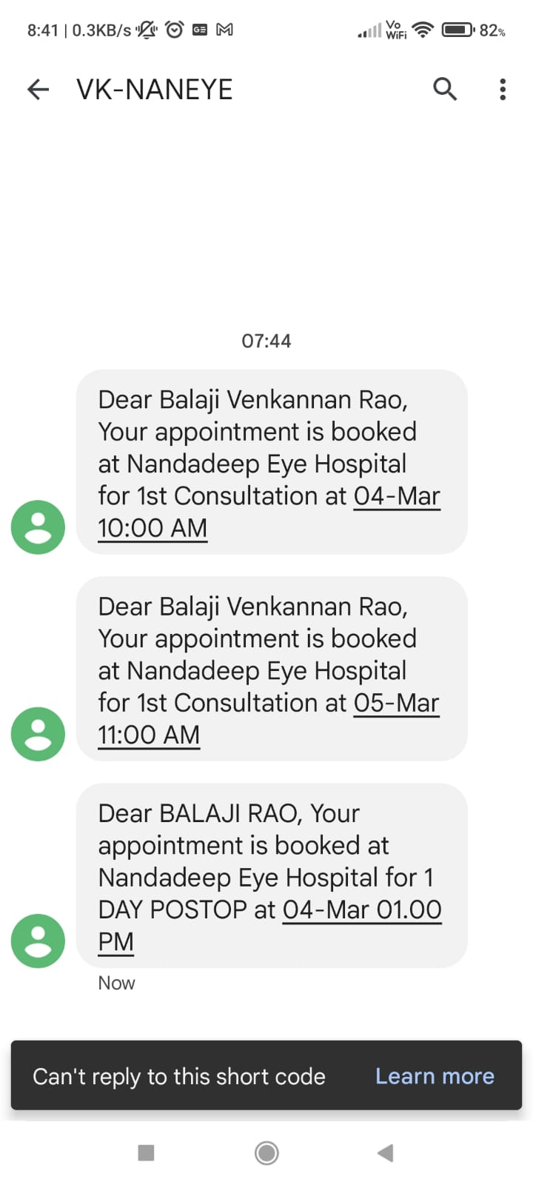
Appointment App
Branch Name
Multi-Branch, Multi-Consultant.
Consultant’s Name
Send WhatsApp to a Appointment Patient
Date
Available Slot Count
Time slots
Empty slots
Booked slots
Send SMS to a Appointment Patient
Color coding for Services and Consultant for visual differentiation
Notes:
Our Appointment app is multi consultant/multi branch(also what we call Satellite centres). SMS/Whatsapp confirmation messages sent.

Slide 5
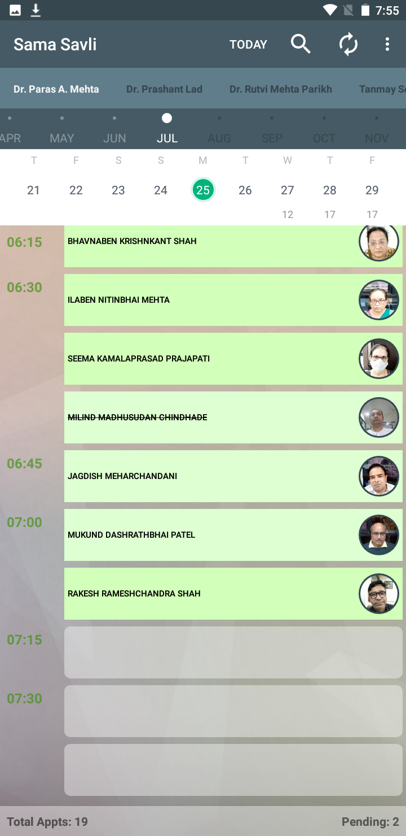
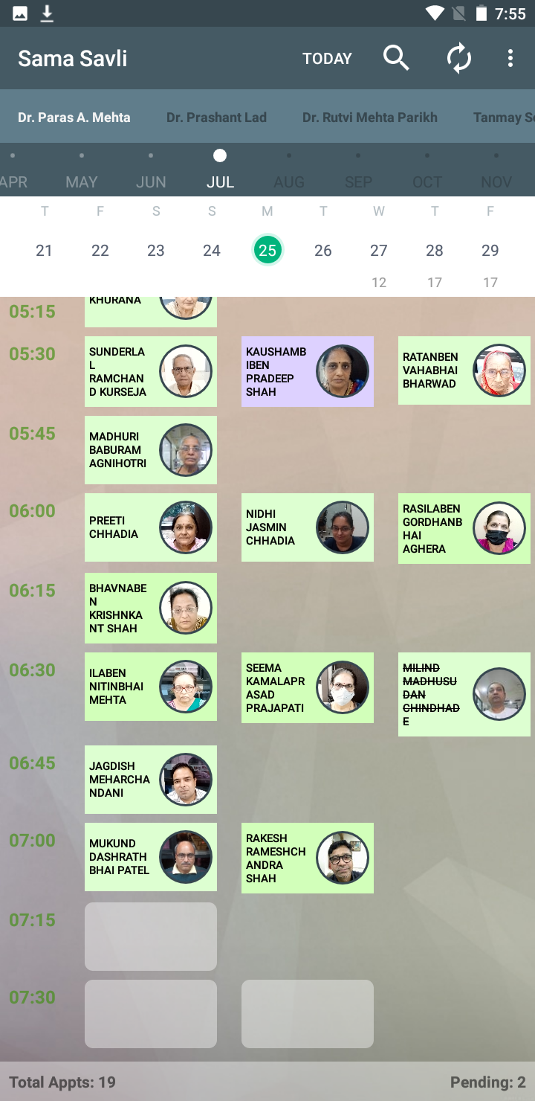
Appointment App
Multiple views of Appointment slots for ease of use
One Column View
Multi-Column View
Notes:
For convenience of viewing more appointments as per device screen size, views are provided like what we are seeing here.

Slide 6
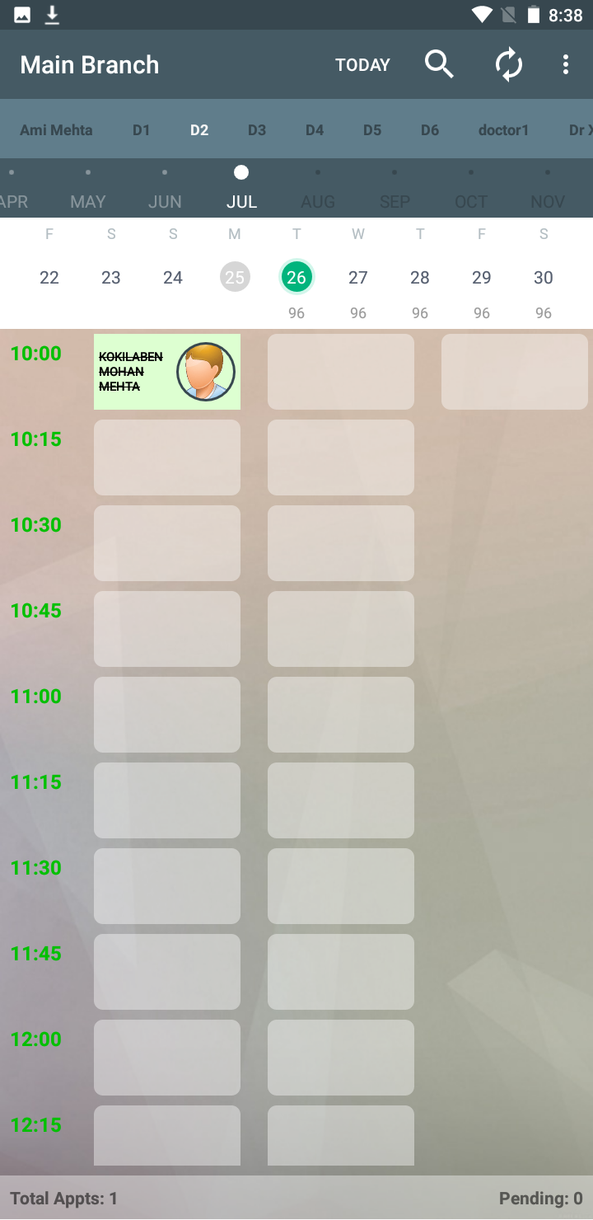
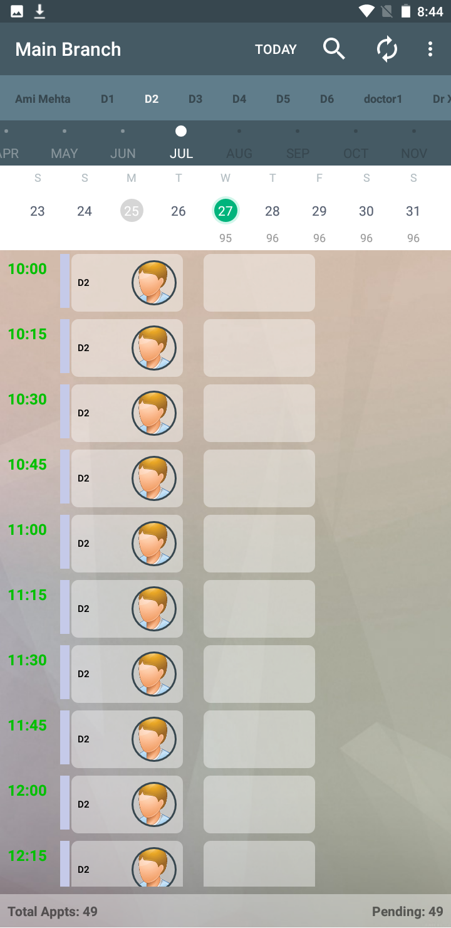
Appointment App
Cancelling an Appointment slot is quick and easy
Day blocking and unblocking is possible
New slot is added, which can be given to another patient.
Based on entered values, the slots are blocked for selected consultant.
Cancelled slot
Newly Added Slot
Notes:
Cancelling appointments and blocking a day for a consultant can be done as can be seen.

Slide 7
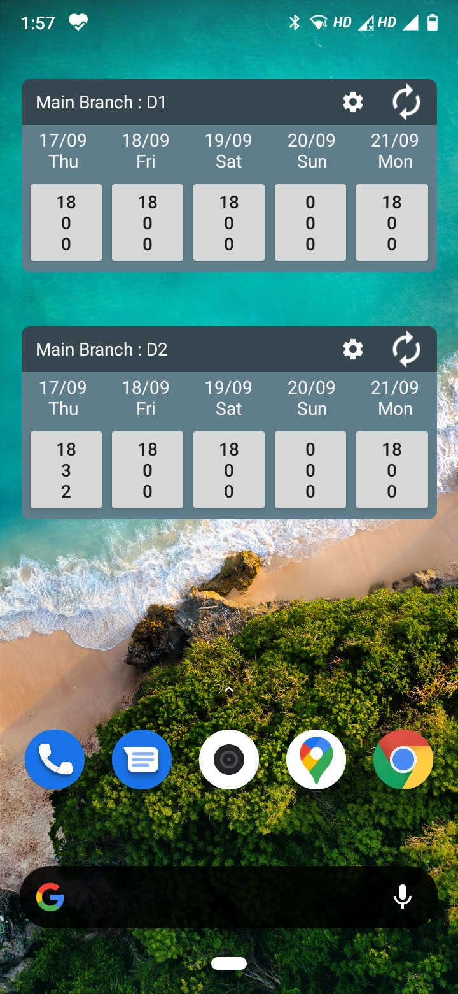
Appointment App - Widgets
Best way to use Appointment app is by creating a Widgets.
Create a Widget per consultant per Branch
Branch Name
Consultant Name
Today’s Date
There are three rows per day
1st = Total Appointment available
2nd = Appointment booked
3rd = Patient issued token at clinic
Notes:
Widgets are shortcut tools to various consultant/branch combinations enabling quick access.
They route you directly to that consultant branch appointment screen. Shows status today + 4 days at a glance.
The consultant needs to just see the widget on his phone for his appointment status at any point of time as to how many appointments and how many have arrived?
Even the staff is able to handle the patient call for appointment with widget view as seen above.

Slide 8
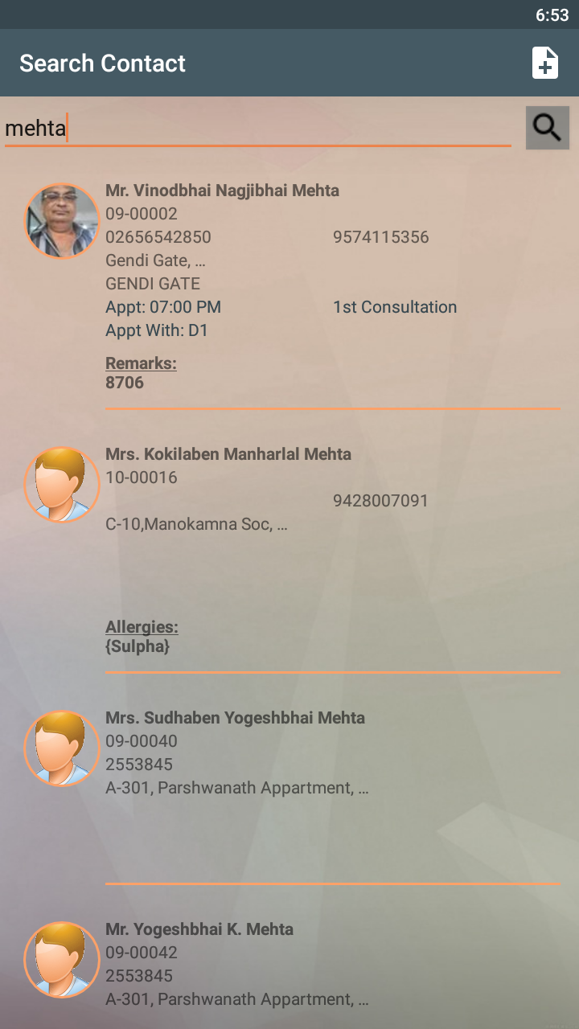
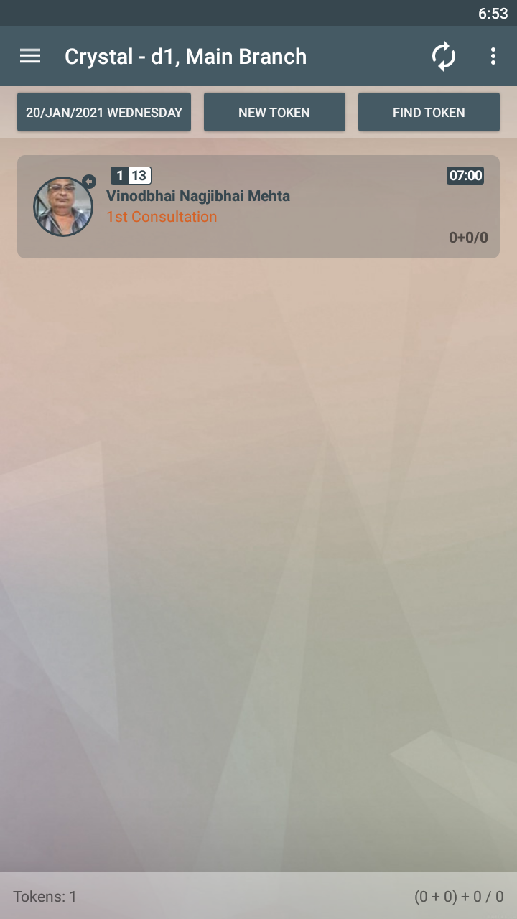
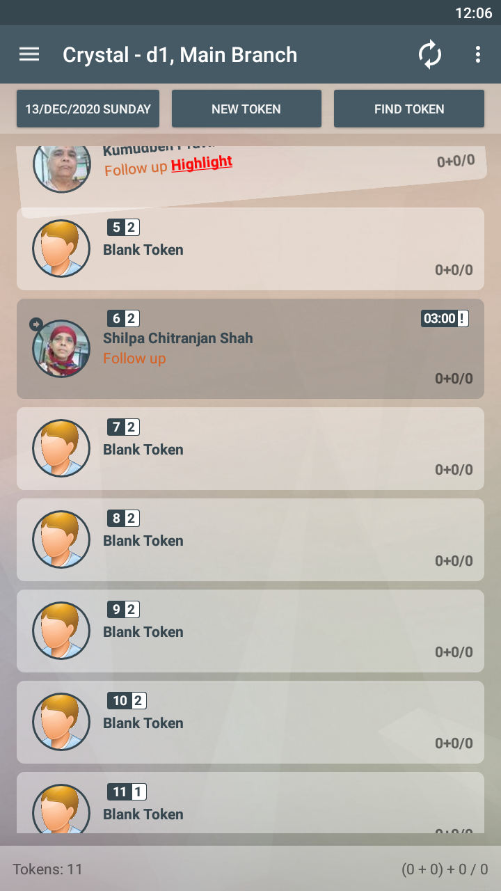
Appointment App
Appointed Patients are autosensed by Crystal EMR App on arrival
03:00 PM
Notes:
The appointments are autosensed as shown above and tagged with time as appointment on registration on arrival.

Slide 9

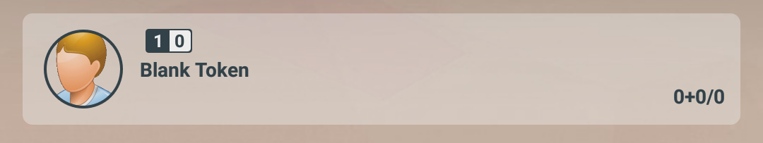
Tokens
Token is an encounter with patient at clinic for any service
( Consultation, Surgery, OCT, Perimetry, Laser, Post-Op Assessment etc )
→ Token Creation is first interaction with patient at clinic ( arrival time )
→ Token always reflects current status of a patient.
→ Once the token is checkout, it stores the exit time of patient.
→ Tokens by themselves are a pool of information and useful during running live daily patient flow.
Notes:
Patients are arrived in Crystal EMR with creation of tokens. This also in a way records the check in time of the patient for whatever service he has come to the clinic.Just for clarity, If a patient come to take appointment, obviously he does not need a token. Or if you need to review data, tokens are not needed.

Slide 10
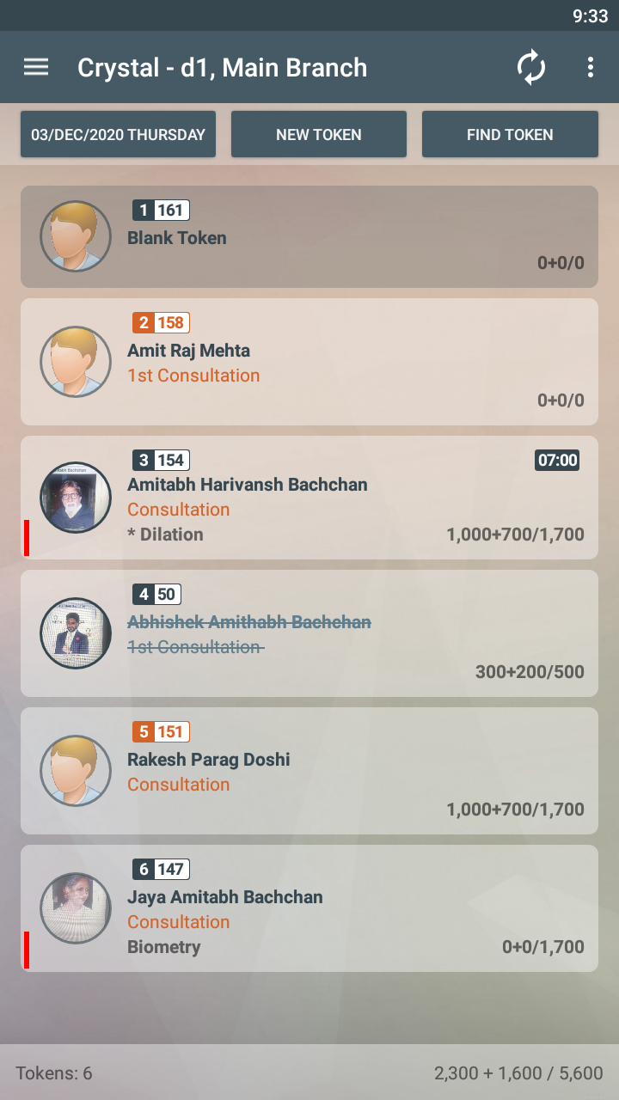
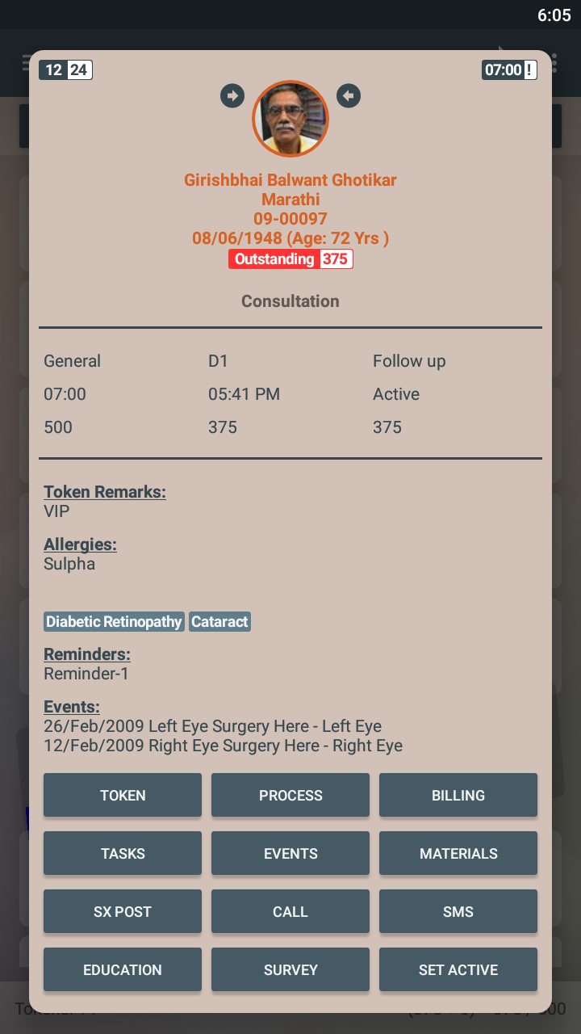
Token Details
Token Number Blue Background: Existing patient
Orange Background: First Time Patient
Time in minutes
(Time from token creation)
Appointment Time
(! = Appointment Patient arrived 60 mins before/after the appt time)
Right & Left Eye Event Indication
1
1
Token Level Attendant color
Undergoing Stage Color
(Ex. Dilation)
Total Suggested Amount
Patient Name
Received Amount in Non-Cash
(Debit Card, Wallet, Cheque etc)
Patient Photo
(If flashing, meaning Patient needs attention)
Token Level Service Name
Stage Assigned but not Started
Received Amount in Cash
If Asterisk ( * ), meaning Stage is undergoing
Notes:
Tokens are a pool of information. They reflect the order in which patients have arrived, minutes since they have arrived,
whether appointed,Service for which they have come to us if operated or not,
which stage of opd patient(waiting or undergoing that stage, like *Dilaton is undergoing dilaton, same you will see tokens with Optometry,Examination etc which are stages patients go thru with us normally)
Patients Photo(optional though) for easy identification in heavy opd esp with same name patients issues we face
Billing details is also reflected(cash+others/suggested)
Color coding is also provided for consultant/stage as can be seen for easy tracking by our staff.

Slide 11
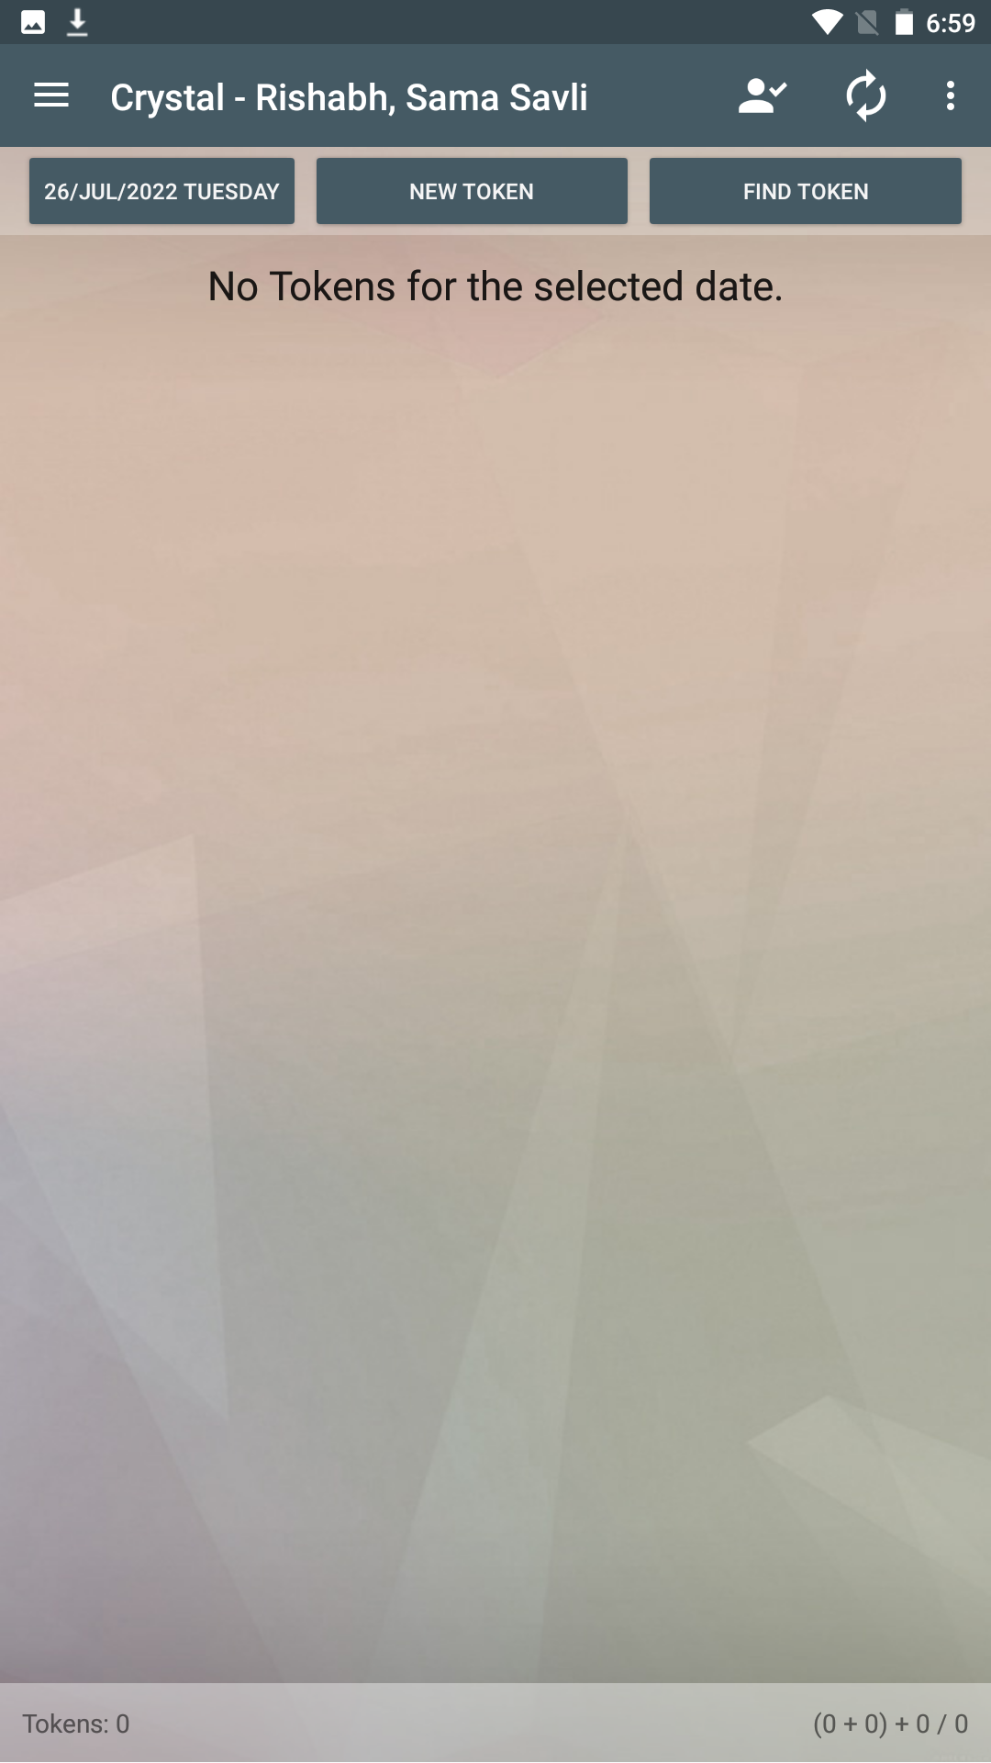
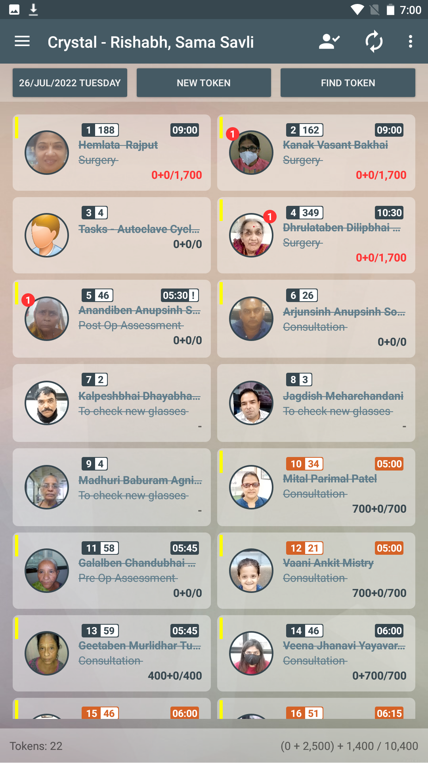
Crystal EMR App - Home Screen
Start of OPD/IPD
Typical Daily OPD/IPD
OPD / IPD module:
Caters to patients data right from arrival to departure involving the whole flow of visit related data from :
Registration
Visit Data Entry and Reports (Visit Report/Specs Presc/Medicine Presc)
Billing
Inventory management
Surgery related info capture and reports (e.g.Discharge summary)
Task scheduling
Events recording
Surgery scheduling
Click to Create new Token
Notes:
This is the HOME screen of crystal. You would be spending 75% of your time on this screen, so the name “HOME SCREEN”. You create token every day for each arrival of patients. All tokens created anytime are stored in the day created and are always available.
Creation of token is by clicking on the ‘NEW TOKEN’ button and assigning the arrived patient to it . A normal live opd screen is shown so you get a feel of the running live opd in crystal emr. All patient visit related data capture and reports will be done through these tokens as can be seen above list on right side.

Slide 12
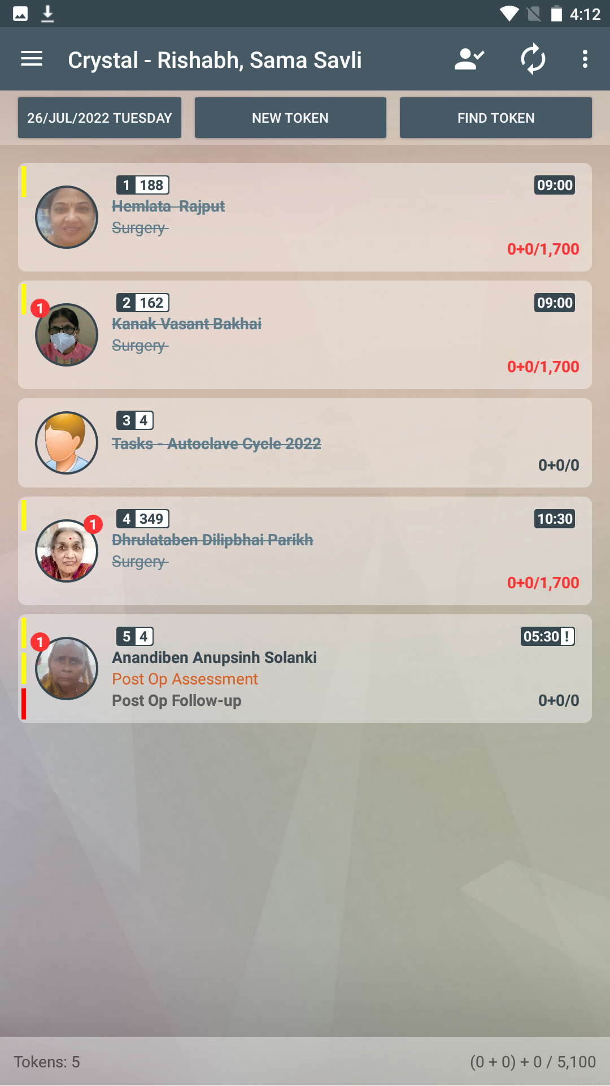
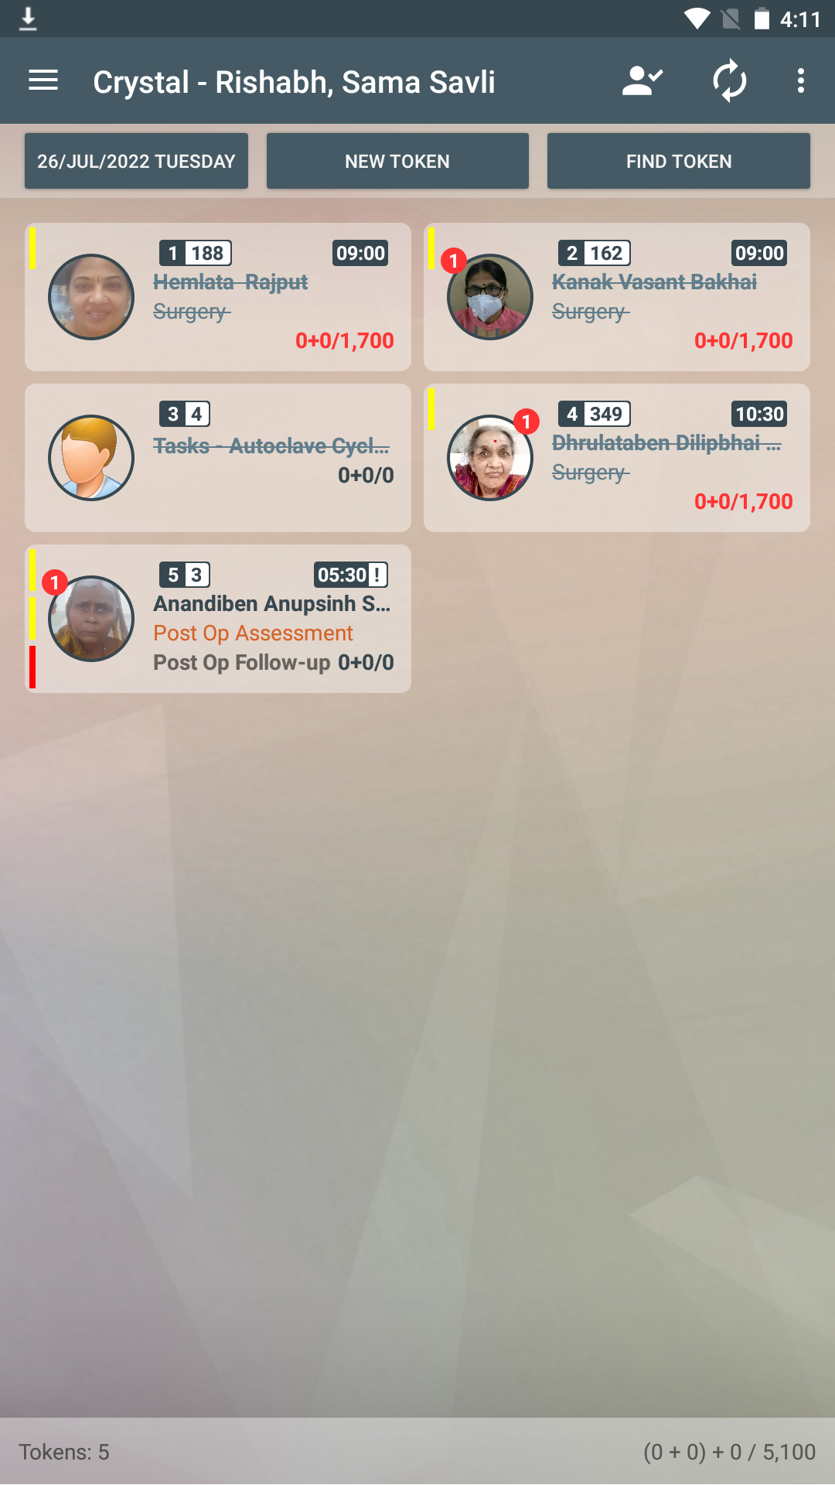
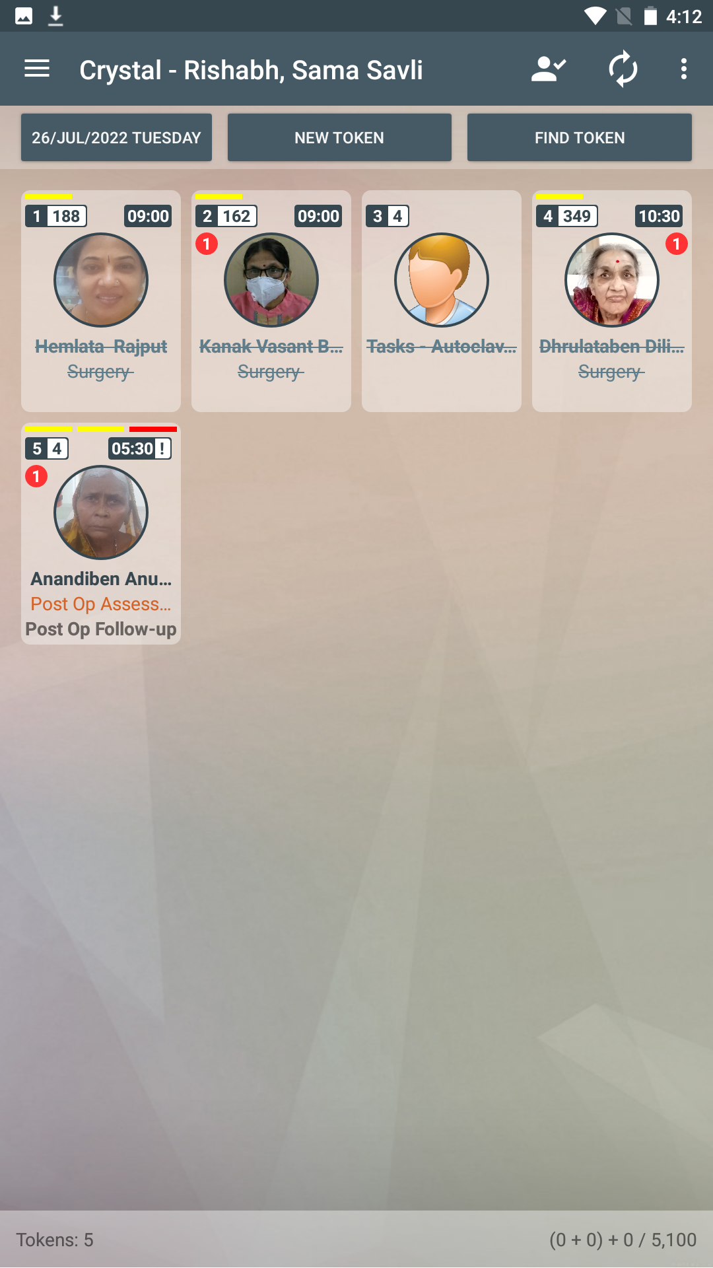
You can Tile the Tokens in multiple columns to accommodate more view per screen size
One Column View
Two Column View
Multi-Column View
Notes:
These above shown are various views of the same home screen as per your convenience and opd size and device screen size you can choose. The same will be remembered, when you login next.

Slide 13
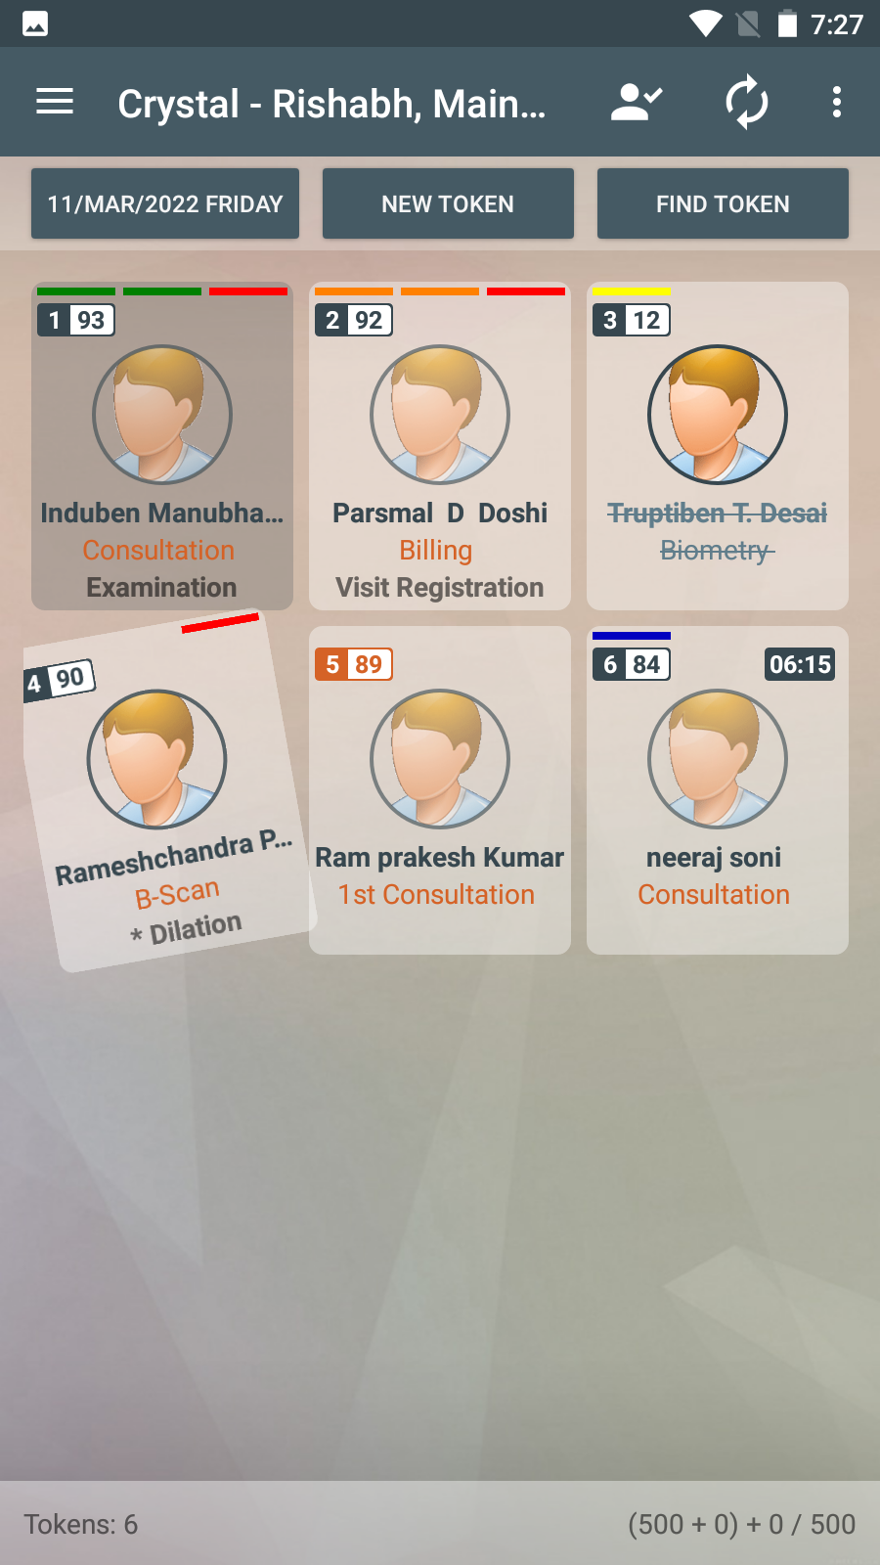
Tokens provide various information about patient at a glance in live OPD
Existing Patient
Ongoing Stage
Check-out Patient
Waiting for next Stage
*
Appointment Patient
New Patient
Dilated Patient / VIP Patient
No. of Tokens
Amount
Notes:
Here we have just explained the reading of a live OPD tokens. How to identify if existing or new,dilated patient,appointed patient,minutes elapsed since arrival and purpose of visit help us in efficient OPD queue management..

Slide 14
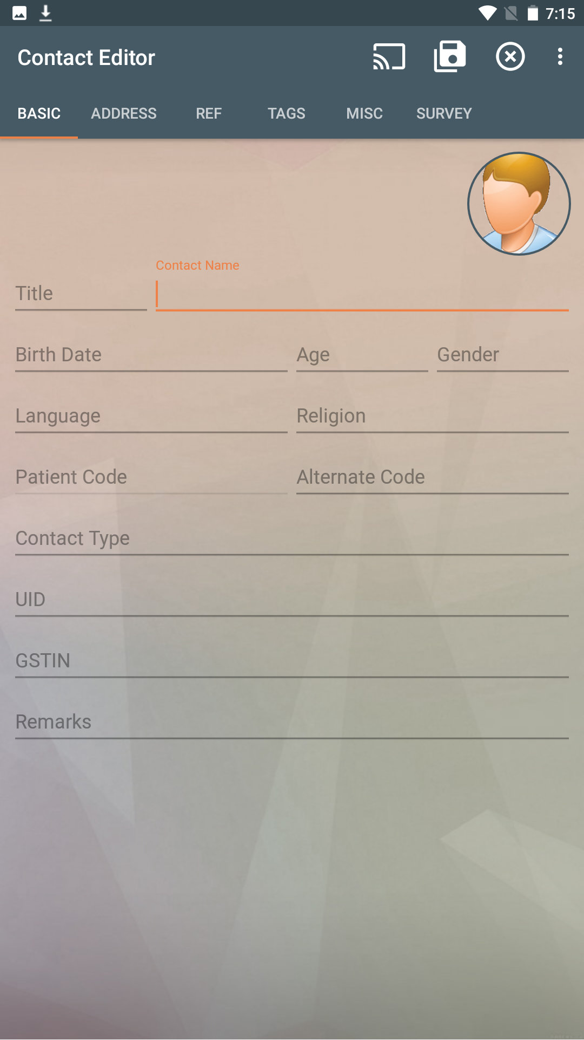
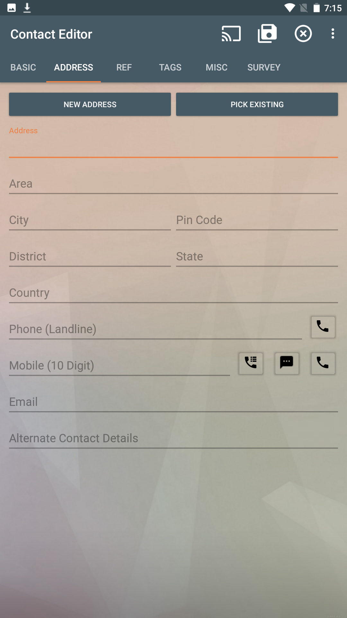
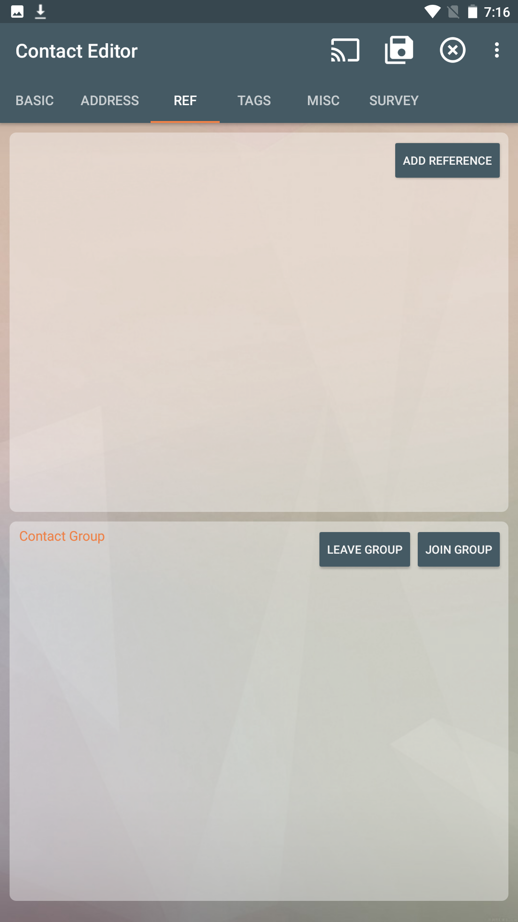
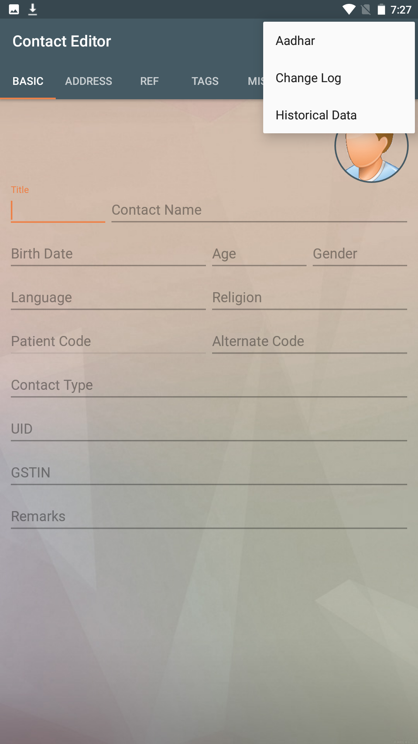
Patient’s Demographic information page
Option to Scan Aadhar Card to get demographic info.
Mr.
Mohan Raj Kumar
Hadapsar
12/01/1980
43
M
Pune
411028
Hindi
Hindu
Pune
Maharashtra
India
9812345678
test@email.com
Notes:
This is new patient registration on arrival. Simple entry and self explanatory

Slide 15
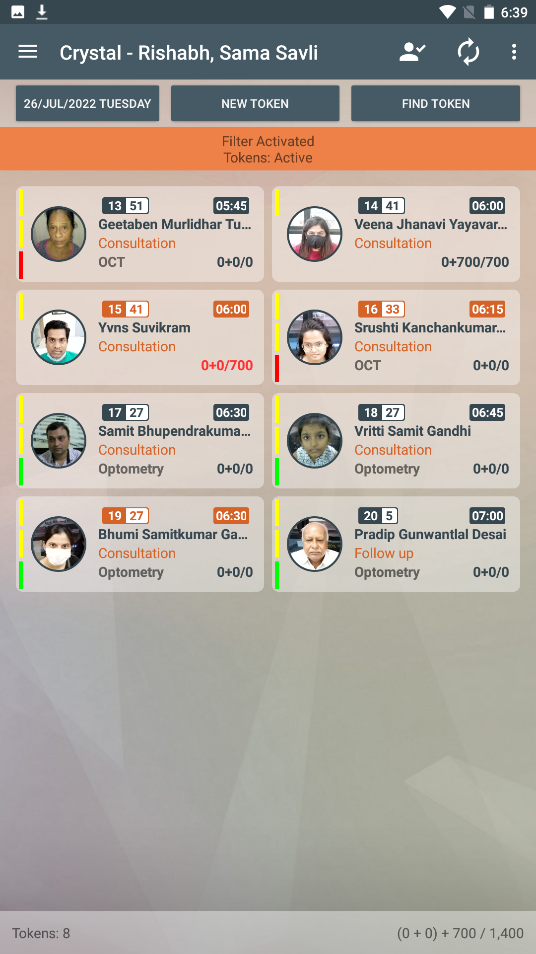
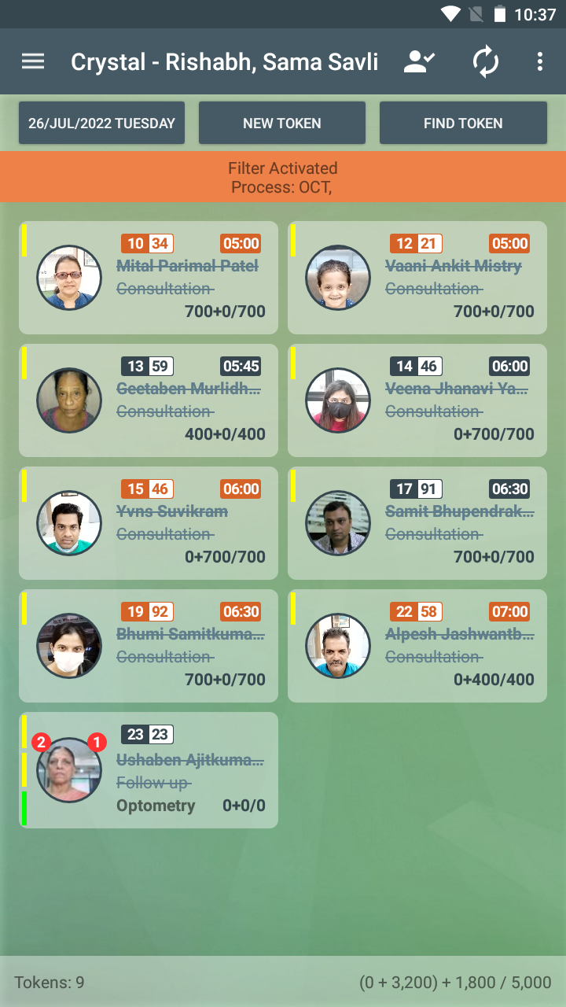
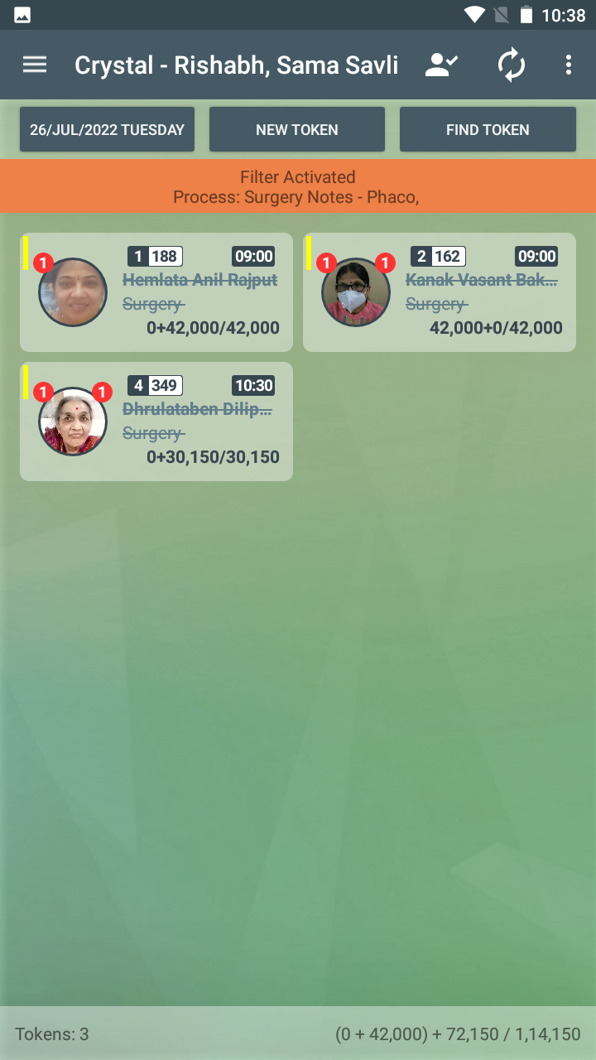
Different Views to see only relevant Tokens
For efficient OPD flow management, Tokens can be segregated depending on various views :
Active Tokens
OCT
Surgery
Notes:
These are various views of the home screen to help in OPD management.Sometimes we see post op patients waiting, whom we know is just a short check of iop and vision, we can just allow those patients to be seen first by the opto/doctor,so disposal is faster and opd load is manageable. Also tokens can be viewed thru various other views. Above are the basic most used views.FYI, Active tokens are tokens which are not checked out.Checkout of tokens is important so live active opd view is meaningful to staff as well as consultants. I am sure you appreciate this fact we all face in daily opd of being able to know how many patient wait for us.

Slide 16

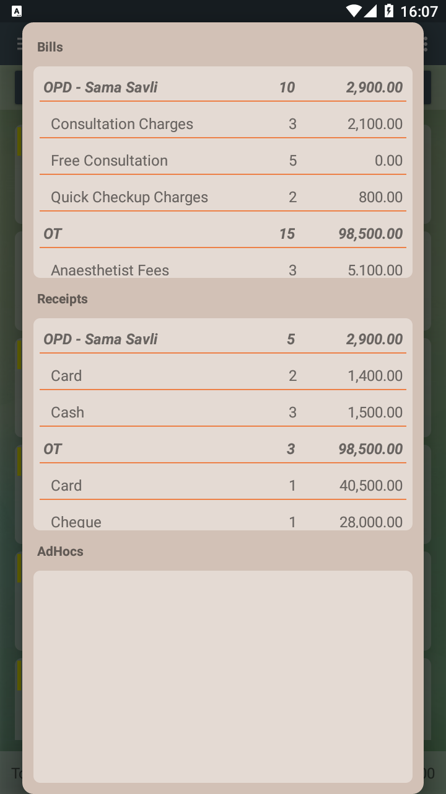

Daily Revenue at a single click
Bill Generated Amount
Receipt Generated Amount
Adhoc Received Amount
(0+1500) + 99,900 / 1,01,400
Click
Notes:
Home screen also show you collections and the details thereof as can be seen above for daily tallying that we normally do at end of day or handover.We even have a logged in user breakup in case of more than one collection points for easy tallying

Slide 17
TrueDocs
Digital Paper interface
→ Paper form has been used for a long time to maintain the patients records.
→ Papers are easy to read and write. Our CrystalEMR TrueDocs lets you give the same paper experience using your mobile or tablet.
→ This helps you focus on patient care.

Slide 18
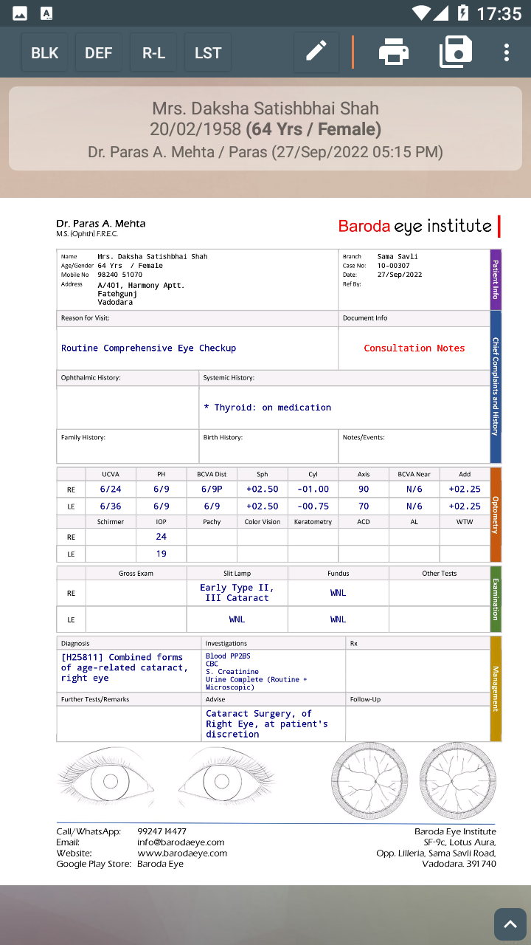
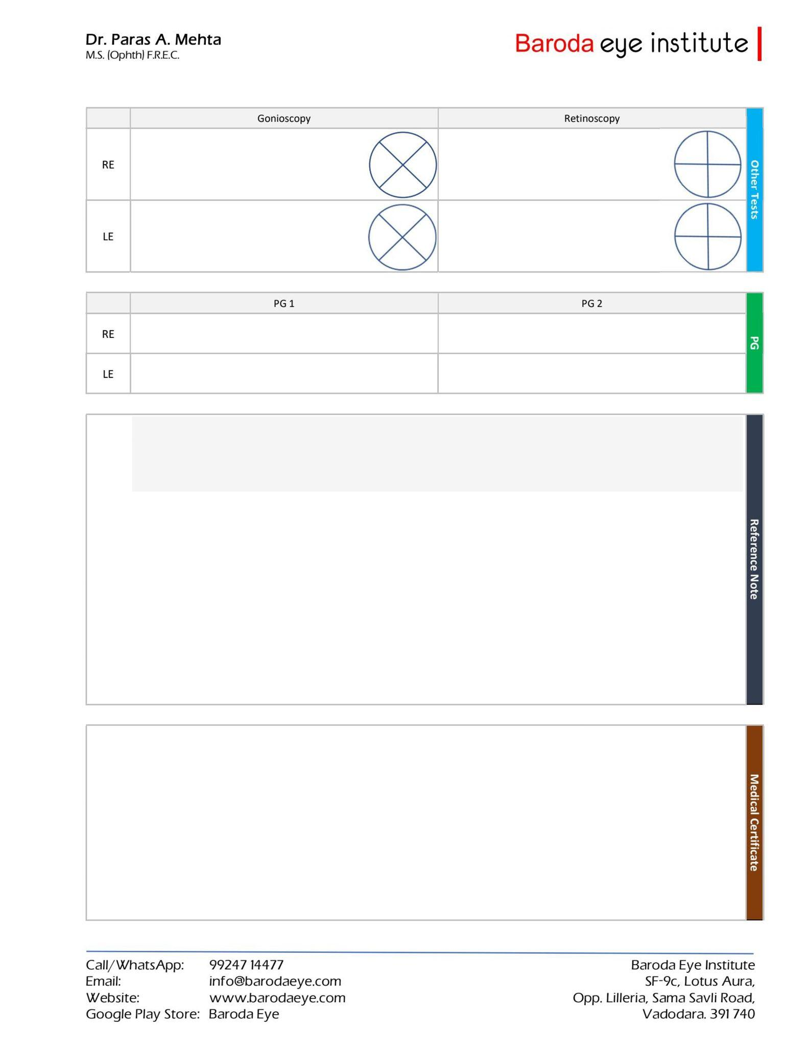
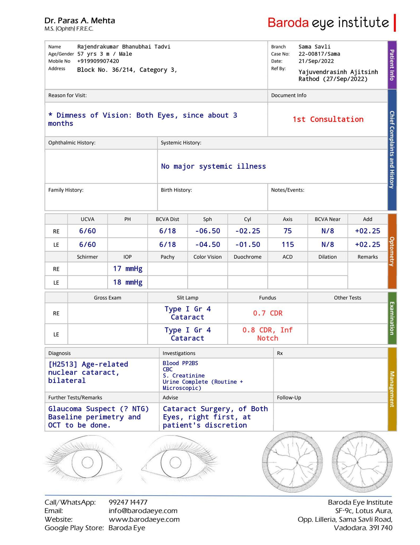
TrueDocs - Various Types

Slide 19
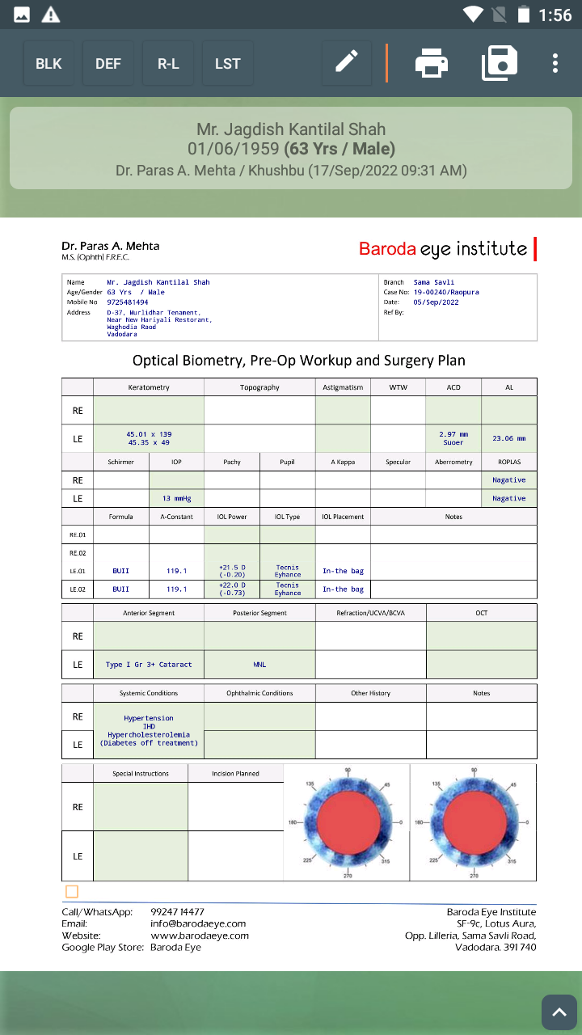
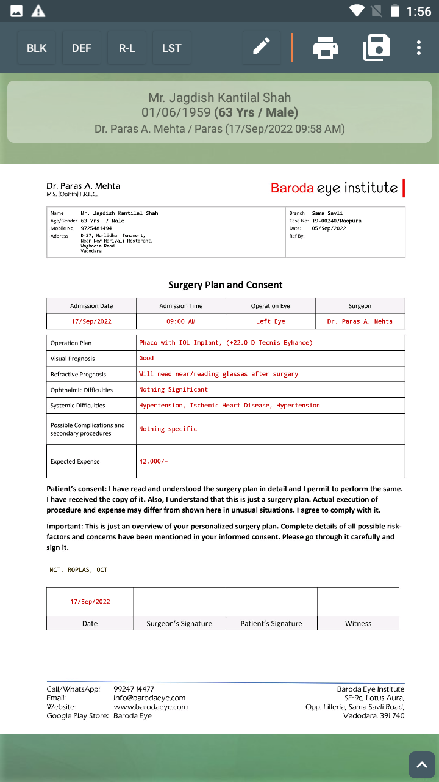
TrueDocs - Various Types

Slide 20
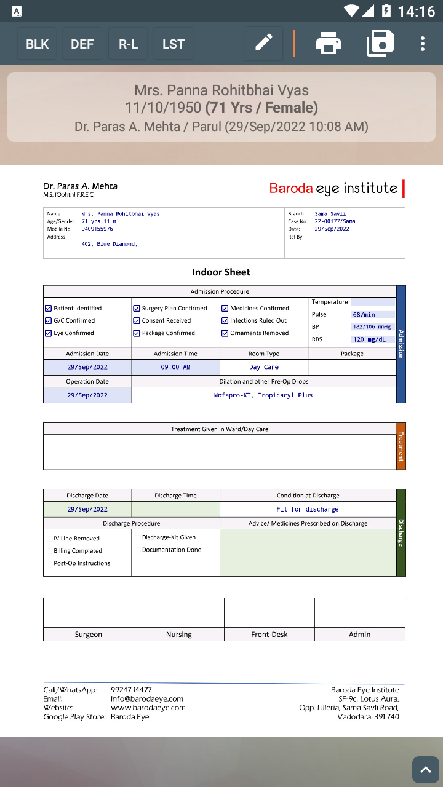
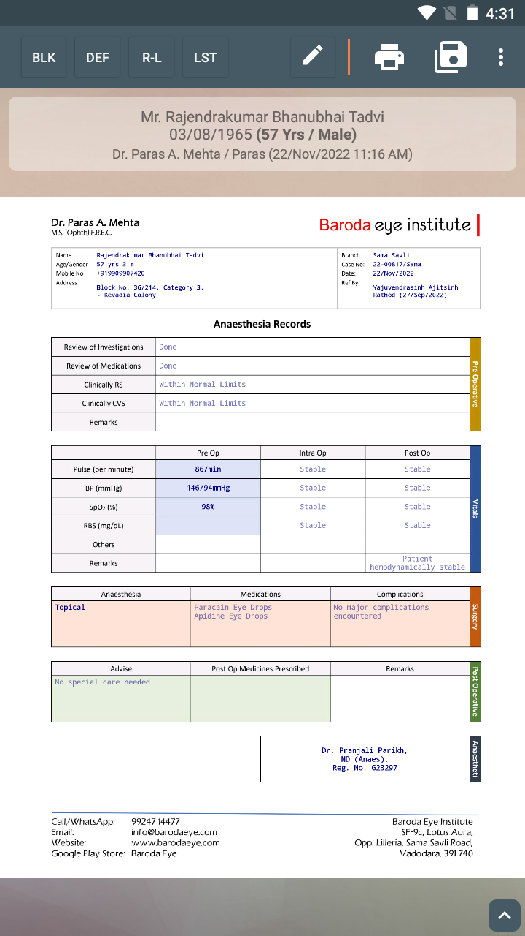
TrueDocs - Various Types

Slide 21
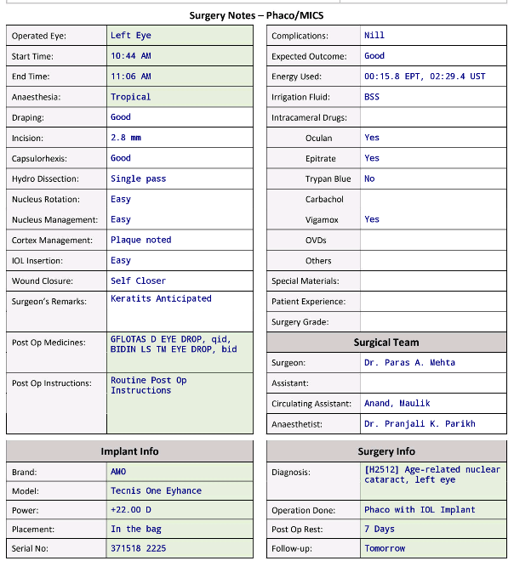
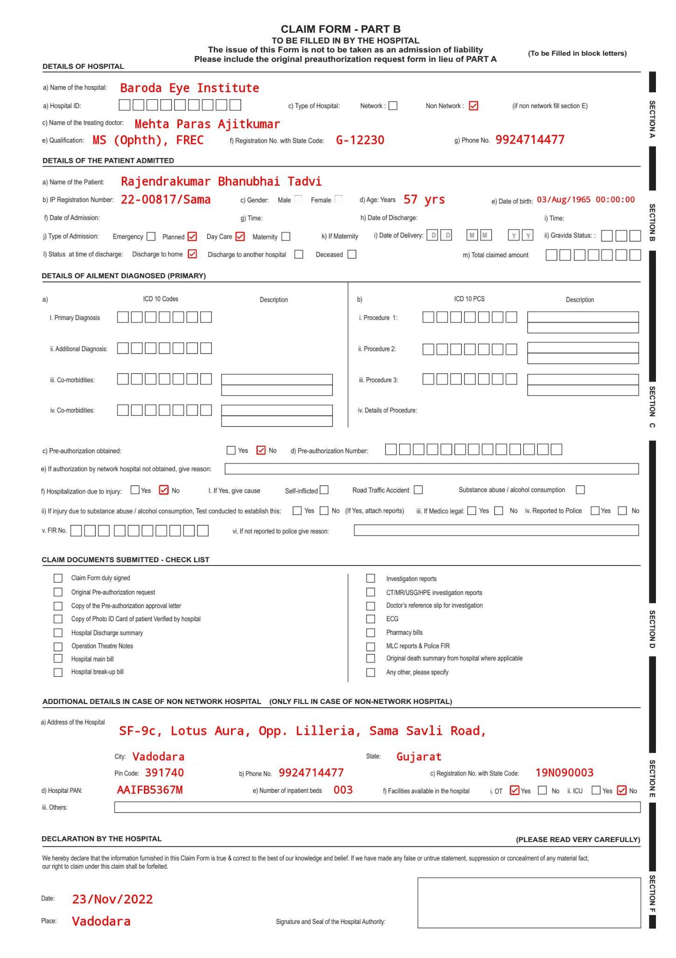
TrueDocs - Various Types
YouTube Clip

Slide 22
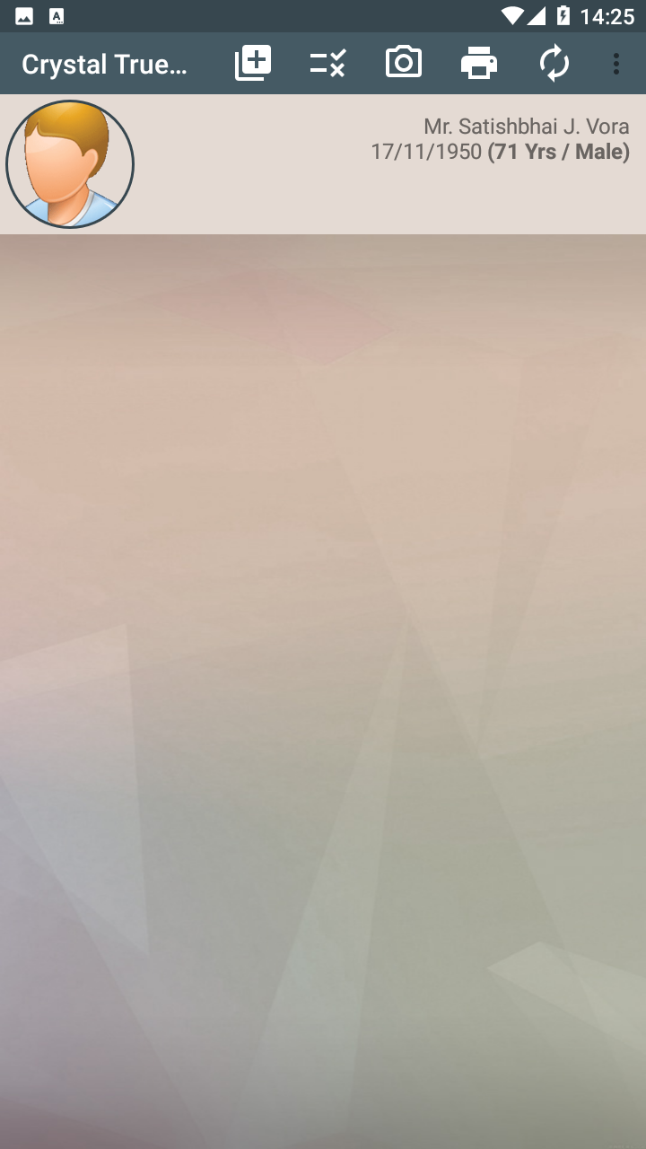
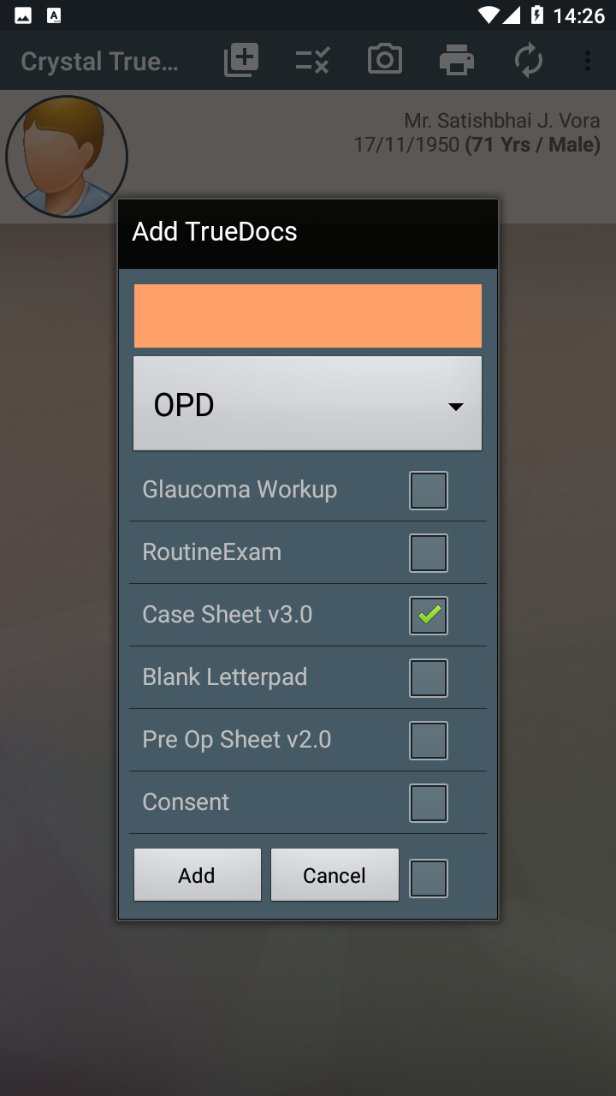
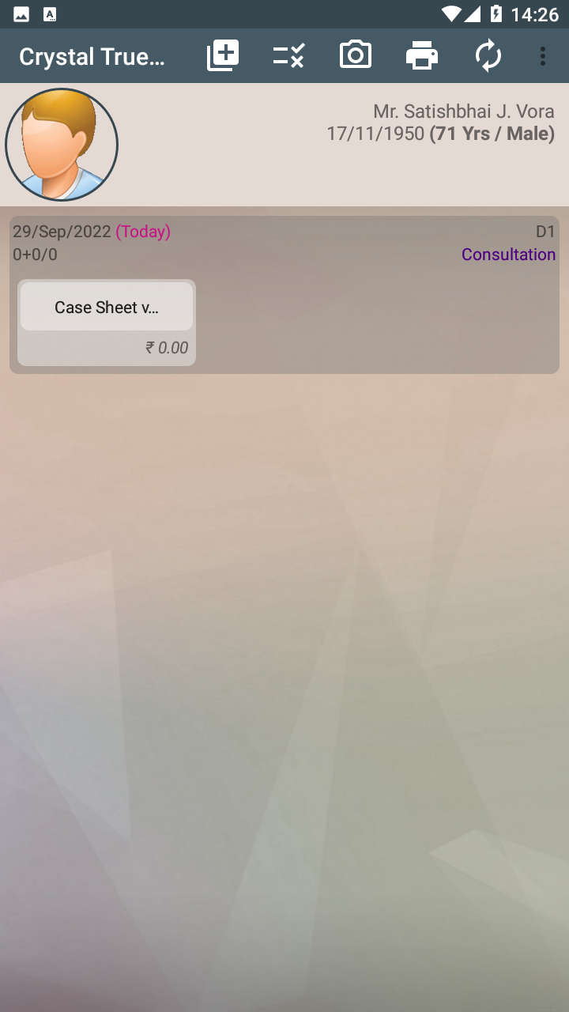
Add a TrueDocs

Slide 23
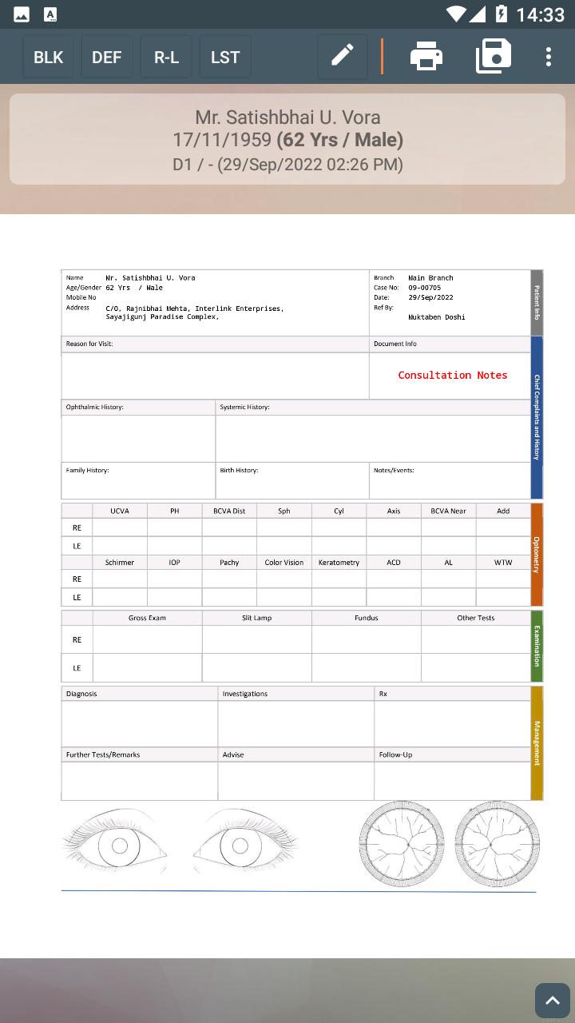
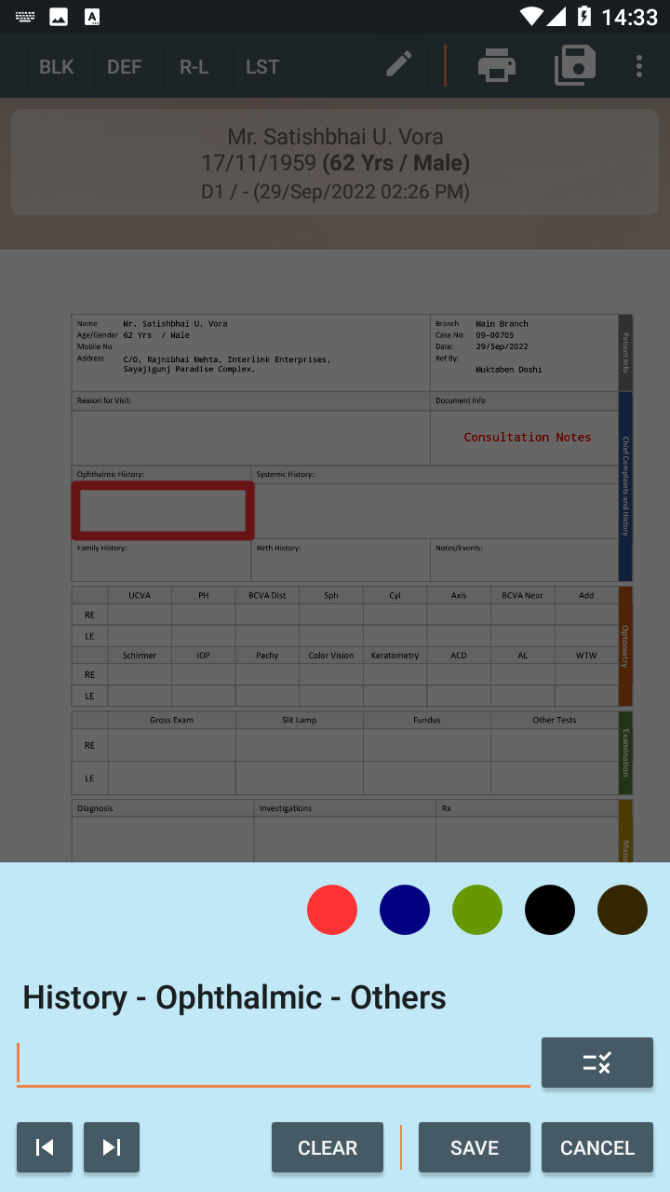
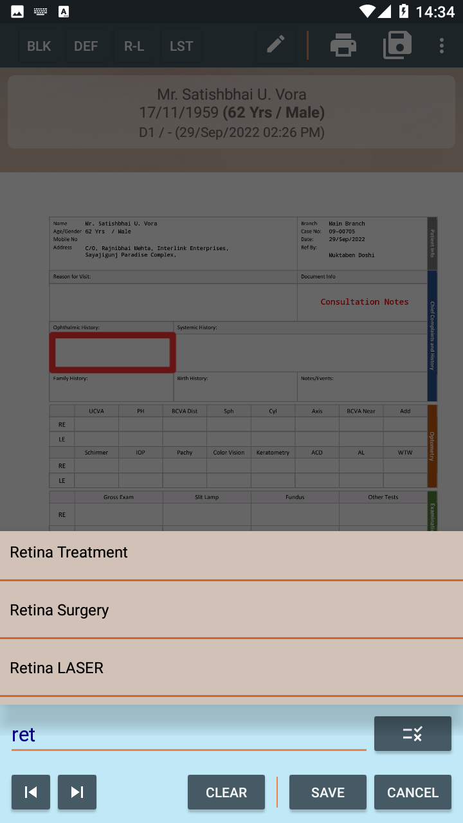

TrueDocs - Data Entry
1.Open TrueDoc
2.Click on any one field
3.Enter the details OR Select from drop-down list
Click

Slide 24
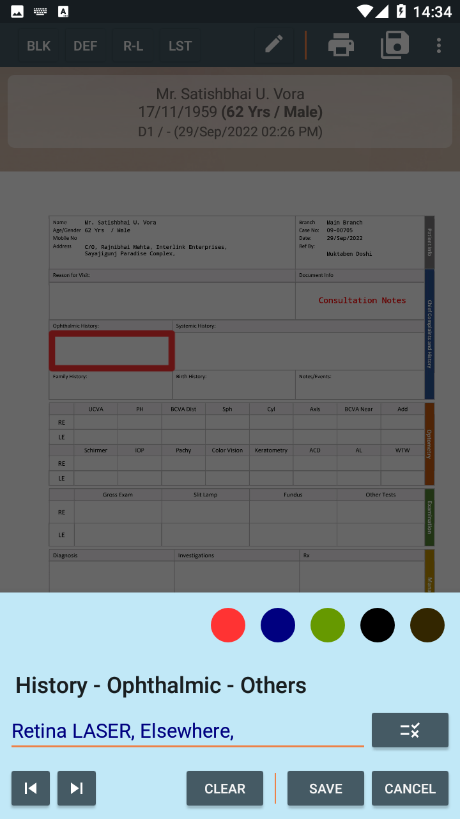
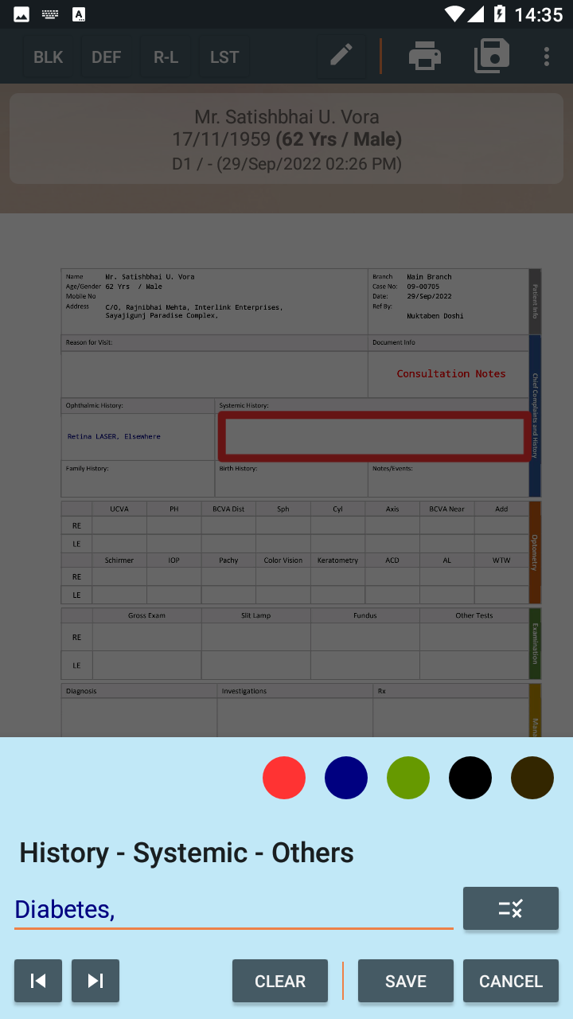
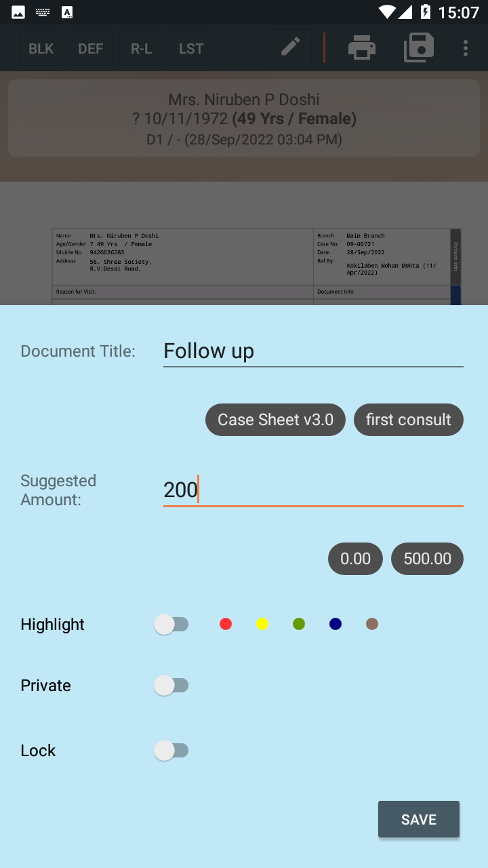
TrueDocs - Data Entry
4.Go to the next field using Next button
5.Save the details using Save button
6.Enter Title and Amount & Save.

Slide 25
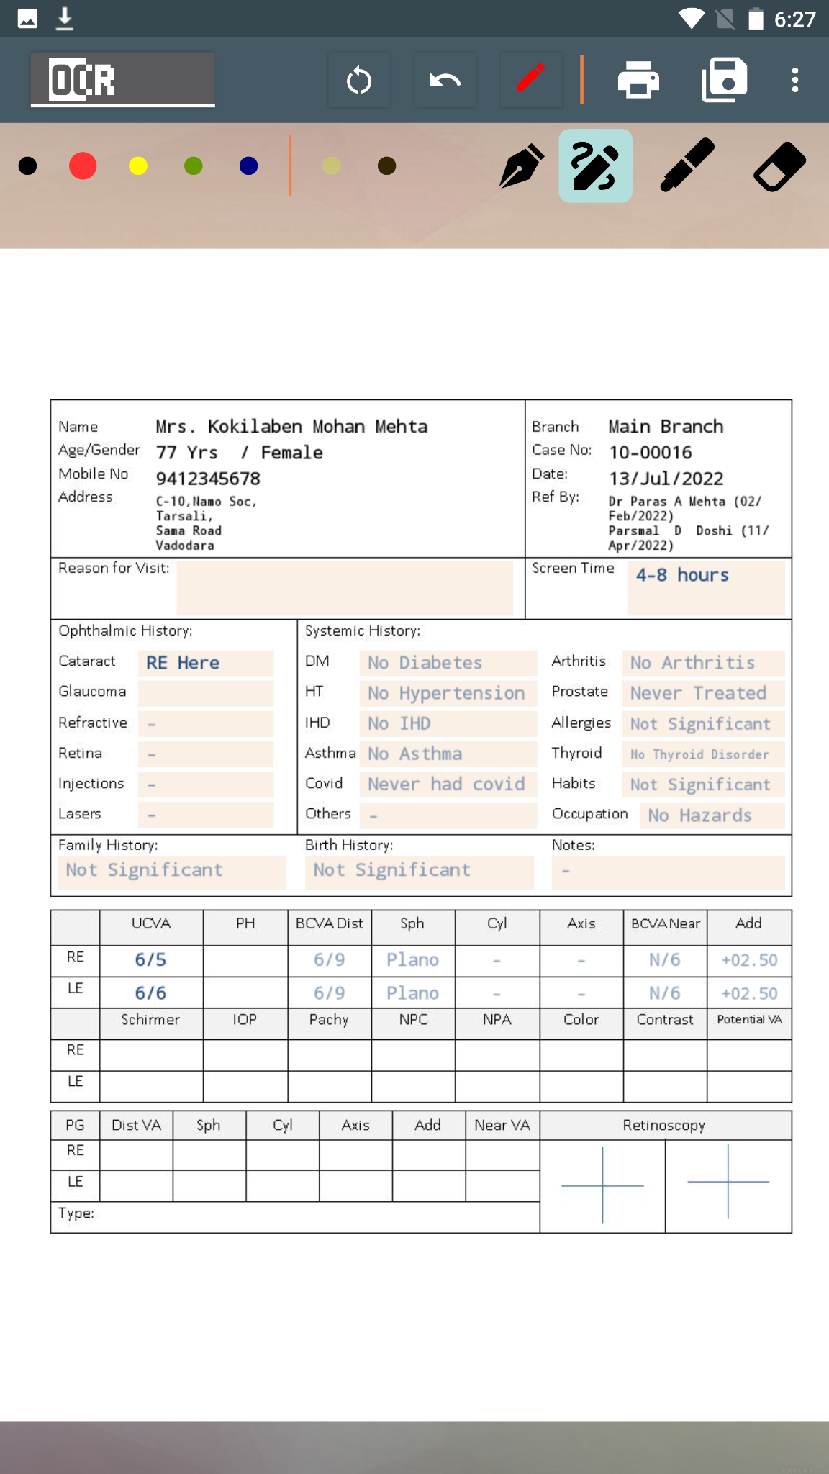



TrueDocs - Data Entry using Digital Pen
Write using Thin Pen
Write using “Handwriting to Text” pen
Press and hold the digital-pen button and tap the appropriate field location
6/9

Slide 26




TrueDocs - Various menu options
Capture Image
Add a TrueDoc
Print Reports
Add Stage
Refresh page
View at home-screen
Long Press TrueDoc to get more options
Document title
Last modified by
Suggested Amount

Slide 27


TrueDocs - View Previous visit values
Long Press anywhere

Slide 28




TrueDocs - Print visit Based Reports
Spectacle Prescription
Medicine Prescription (English)
Medicine Prescription
( Regional Language)
List of Reports

Slide 29



Discharge Summary
Discharge Summary
Medical Certificate
Anaesthesia Notes
Notes:
The surgery data so entered can be printed as discharge summary. Obviously this discharge summary will be as per the clinic practice.

Slide 30


TrueDocs - Delete, Transfer a TrueDoc
Long-press on a TrueDoc & Select Delete option
Long-press on a Source document & Select Transfer option
Long-press on a Destination document & Select Paste TrueDoc option

Slide 31


TrueDocs - Stage Sequence
Stage Sequence shows Patients journey in the clinic for selected day.
Click on Stages icon
List of stages of a patient in logical sequence (along with start and end time button)

Slide 32


TrueDocs - Send Via WhatsApp

Slide 33



Events
The important dates like patient’s surgery (at our clinic), can be saved as event in CrysyalEMR. These events can be added manually or can be auto generated based on Surgery info details.
The purpose is to easy and quick access to patient’s surgical/procedural benchmarks and details at a glance.
Add Date of Operation in TrueDocs
All Events at Navigation Window
Events Page.
Events can be Highlighted
Notes:
In short, are surgeries with eye and surgery name recorded as event. Seen on each recall and on token, helps the consultant to be aware of major milestones in patient care. They are auto generated on surgery entry being saved.

Slide 34





Tasks
Tasks are auto generated on follow up advised.
Select the Follow-up Field from TrueDoc to Create a Task.
Select from Drop-down list to generate specific Tasks
View at Token Level
Pop-up of Task on Each patient recall
Various Status of Tasks
Notes:
Tasks are the OPD follow up advice being given by consultant Follow up for OCT after 2 months. Such Tasks are generated and pending tasks shown at each recall. On the arrival for said task, the user should mark the task as executed.

Slide 35




Images can be attached at each Stage
Notes:
Attachments like OCT,Perimetry,Lenstar,Biometry PDFs/JPG from those pcs, if on same LAN, can be attached to appropriate stage. Another way of doing this would be taking a snapshot of the printed document via the Capture button at each stage which uses the device camera.

Slide 36




Post a patient to Surgery
Click on SX POST button
Surgery List
Surgery List for Print on A4 Page
Select Surgery date
Surgery List Options
Notes:
Post a patient to surgery is a click away.Print format can be per clinic practice.

Slide 37




OPD Billing
New Bill Page
Charges List for Billing
Bill Landing Page
Notes:
Nothing much to explain in OPD billing. Your clinic charges list can be pre-fed into Crystal EMR.

Slide 38



OPD Billing
Generated Bill & Receipt
Bill - Print Preview
Bill cum Receipt - Print Preview
Notes:
Nothing much to explain in OPD billing. Your clinic charges list can be pre-fed into Crystal EMR.

Slide 39



OT Billing
Predefined Packages
Package Breakup
Insurance/ TPA Details
Notes:
OT packages can be preferred into the Crystal EMR,resulting in selection of package, which in turn results in the corresponding package falling in place.
This reduces human error and quick billing. Billing rights to users depend on role.
Editing/creation/cancellation allowed as per logged in users role. This role is defined by the management.

Slide 40


Bills for the Day
Bills for the Day - Group by Consultants & Service
Notes:
View 1 Total bills for the day along with all details
View 2 shows grouping by consultant and particulars. So you can in one glance for any period see how much doctor Xs billing for Consultation,OCT etc etc.
Needless to say this is a most useful view in case of multi consultant scenarios, which most of us are normally into nowadays.

Slide 41


Bills for the Day - Group by Reference
Bills for the Day - Group by Mode Of Payment
Notes:
View 1 shows grouping by reference is also available. No need to explain this aspect as we all are aware how useful this data is.
View 4- CASH/Cheque/CC/DC/UPI–grouping of receipts. Again no need to explain in detail

Slide 42


Surgery - Group by Packages (Lens)
Surgery - Group by Surgeon

Slide 43


TPA Analysis
Notes:
Our financial summary also can show TPA wise patient bills.
The same can be reconciled on receipt along with UTR number.
So at anytime we have a TPA approved list which is not reconciled.

Slide 44


Advances
Advances taken from patients for surgeries and procedures is recorded. This can be adjusted against the final bill. Advances on hand can be seen at a glance.
Notes:
Advances taken from patient for surgery or procedures can be recorded here and adjusted om day of procedure/surgery.
Our Financial summary keeps track of both these transactions.
Unadjusted advances on hand can be seen at a glance.

Slide 45


Employer Analysis
Summary
Detailed View
Notes:
Also financial summary provide employerwise bills details

Slide 46




Survey Analysis
Preset Survey Forms
Survey Form Fields
Survey Form Analysis
Notes:
Customised clinical patient feedback survey can be defined and data captured which can be analysed later

Slide 47

Pending Task Report
Group Tasks
Generate Bulk SMS
Notes:
This gives a real time picture of all pending tasks in our task reni reminder report . Bulk SMS can be generated for such pending patients list.

Slide 48





DashBoard
Dashboard shows various important values of selected date at a Glance
Tokens generated ( New and Existing), Patient check-in time, Patient duration in clinic, Daily Patient count, patient attended by Attendant, Stages/Services offered, Top 10 Stages, Area analysis, Surgery count, Prescribed Medicine Brands, Prescribed Pharma Companies, Reports Generated and much more…
Notes:
On the app DASHBOARD is available reflecting above data. This tool is available only to authorised users.OPD practive patterns for day/month can be seen. Medicine prescribed, Pharma companies prescribed ,reports generated etc etc.

Slide 49





Inventory Management :
Add Material :
Consume Material :
Billing of Material :
Transaction Type
Scan the Batch number using device camera.
Notes:
A simple inventory module make OT material receipts and issue as per patient in OT and stock position review very easy.

Slide 50

Material Turnover Report:
Notes:
This is the stock review. Patients issued also can be displayed if they are issued in the said report range.

Slide 51


Other MIS Reports
City area-wise patient Count.
Patient Count - Old & New
Notes:
Areawise count
New patients for a period

Slide 52


Other MIS Reports
Service Summary
Appointment Status
Notes:
Visit service summary helps us in analysing purposes of visits by patients and numbers. Also indicates time taken
Appointment status report analyses over a period how many cancelled or arrived late. This helps in keeping track of such patients if they are repeatedly doing this.

Slide 53



Other MIS Reports
Income Analysis
Reference Analysis - Bill-wise
Medicine Prescribed
Notes:
The above 3 report are self explanatory. Bill income headwise analysis, Reference analysis - bill wise, Prescribed medicine pattern

Slide 54


Other MIS Reports
Document Analysis
Tagged Patient List
Notes:
Reports generated pattern. For eg no of spectacle prescription printed for a period…
Patient tagging segregates patients as per tag. This is a good way of tracking Interesting cases,Retinopathy conference, glaucoma suspects etc etc

Slide 55


Outstanding Bills
Notes:
I dont think this outstanding bill needs any explanation. This is a major worry point for all of our clinics.

Slide 56


Stage Analysis
Notes:
A Huge NABH requirement,This report calculates average time taken per user per stage. And also calculation of the same can be seen. For Eg. Optometry Username saw 5 patients in Optometry at a average of 25.33. All these 5 patients can be seen along with their individual time too. So on andso forth. It is to be remembered, Visit checkin time-stage checkin time difference is the time for the patient to reach optometry, which is what the NABH wants as analysis.

Slide 57

Clinical Analysis
Notes:
Each field in Examination and consultation or for that matter in all such similar text based data entry form can be analysed as above.

Slide 58

Change Analysis- Stage
Notes:
Many a times , we need data of preop and post after surgery or procedure or injection. This report does just that. Keeping a key process say surgery - we can observer optometry stage around that surgery. Above you can see a similar analysis for a patient. His pre and post optometry can be seen

Slide 59

Change Analysis- Field
Notes:
Change analysis–Keeping a key process say surgery - we can observe specific fields around that surgery. Above you can see a similar analysis for a patient. Patients pre and post vision can be seen

Slide 60


Material Turnover

Slide 61


Various Other Features :
Visit count of Patient till date
IOP Graph
Notes:
IOP Graph can be for the selected patient in the all stage screen stage
Visit numbers and service details can be seen along with days elapsed per visit.

Slide 62








Send WhatsApp, Email & Save as PDF
Email
WhatsApp
Save as PDF
Spectacle Prescription
OCT
Notes:
Also interapp share with crystal can be done.

Slide 63







Crystal Attach
OCT/ Perimetry/ Slit Lamp etc images & PDF can be directly attached from those computers if on the same LAN.
Select Patient’s Token
Select process name for selected Patient
Notes:
Attaching images from OCT ,Pentacam or other windows based pc attached medical devices can be attached via our window based attach module.

Slide 64


